Slide 1

RNAseq analysis in R

Slide 2
Goals/Agenda
Why do RNA-seq
Practical advice (read depth, replicates)
Differential testing
Basic RNAseq analysis - template script using class data
QC
Visualizing data
Normalization
Experimental designs
Batch effects
Deriving biological meaning / enrichment analysis
Notes:
Here are the goals and agenda for the next couple of classes. I’m guessing this will be 3-4 lectures, we’ll see how the pace goes.
Plan is to start today with a lecture about RNA-seq techniques, approaches, and the steps involved. The overall goal is to explain and then walk through the practical steps of analyzing RNAseq data using R.
we’ll go through how to explore and QC your data. There will be some material about how to QC your data and make sure everything looks right. This is where being a biologist and computational biologist is important since you’ll understand you're samples you’ll know what to look for (sample swaps, genes that should show up in your data, etc)
The next class we’ll work through some examples for how to go from counts to differential genes.
Class 3 to talk about visualizing data and getting biological meaning from them. We’ll talk about how to make things like heatmaps and annotate functions and do enrichment profiling and stuff like that.
Class 4 will be going through the code for those methods.
We may not take the full class each time, so please interrupt and slow me down if something isn’t clear. Class 1 and 3 will be more of a lecture, with class 2 and 4 being putting some of those methods into practice. We’ll have time for a fifth class if we need to cover more hands-on computational work, or I can be available to answer questions you have about getting your code running the way you want.
I’ll make all these slide avaiable on Sakai and where I’m showing you code snippets I’ll have full Rscripts up on Sakai as well. Definitely try to go through and understand the steps on your own.

Slide 3
Why Do RNA-seq
Measure differences in gene expression between conditions
Better dynamic range and isoform/transcript information than microarrays
Detect structural variation, fusions, or single nucleotide variants
Identify new transcripts/genes
Measure ‘weird’ transcripts
Applicable to single cells
Less technical bias than microarray
Notes:
RNA-seq has largely replaced microarrays, with a few exceptions like some copy number analysis and maybe some really common gene panels or something people like. But I’ve only ever run like 1 or 2 microarrays (as a rotation student) . It can still be useful to learn how to analyze that data since so much is in GEO (gene expression omnibus). Analyzing other peoples data, a so-called data parasite, is one of my favorite things to do since at least reagent-wise its free
The big thing you want to do is “Measure differences in gene expression” and this can be expanded to look not just at a a gene as one thing, but isoforms or alternative starts or polyA sites
A lot of folks, especially in cancer are looking for “fusions, structural variants, or single nucleotide variation” that might indicate a mutation of some sort.
Possible to identify new genes - with RNA-seq you don’t necessarily need a transcriptome before you start, so this can work on non-model organisms or poorly annotated genomes. This will require more reads and thought in how you analyze the data.
You “can analyze weird transcripts” - some transcripts are poorly represented on commercial microarrays like lncRNAs or various small RNAs or transposable elements. You can map really any transcribed region of the genome. You can also assay RNAs associated with the ribosome or different subcellular locations (cytoplasmic vs nuclear RNA) or enhancers. This may all reveal important biology
More recently, single cell RNAseq, has started to become really common. My personal view is analysis has a long way to go here. I read there are more papers with new analysis methods than there are RNAseq data sets and people handle variation/replicates poorly right now. BUt its pretty clear more and more single cell data are going to be coming during the time you’re all here (at least in UNC, but maybe in this module)
There are fewer technical artifacts in RNA-seq

Slide 4
Why Do RNA-seq
Measure differences in gene expression between conditions
Notes:
RNA-seq has largely replaced microarrays, with a few exceptions like some copy number analysis and maybe some really common gene panels or something people like. But I’ve only ever run like 1 or 2 microarrays (as a rotation student) . It can still be useful to learn how to analyze that data since so much is in GEO (gene expression omnibus). Analyzing other peoples data, a so-called data parasite, is one of my favorite things to do since at least reagent-wise its free
The big thing you want to do is “Measure differences in gene expression” and this can be expanded to look not just at a a gene as one thing, but isoforms or alternative starts or polyA sites
A lot of folks, especially in cancer are looking for “fusions, structural variants, or single nucleotide variation” that might indicate a mutation of some sort.
Possible to identify new genes - with RNA-seq you don’t necessarily need a transcriptome before you start, so this can work on non-model organisms or poorly annotated genomes. This will require more reads and thought in how you analyze the data.
You “can analyze weird transcripts” - some transcripts are poorly represented on commercial microarrays like lncRNAs or various small RNAs or transposable elements. You can map really any transcribed region of the genome. You can also assay RNAs associated with the ribosome or different subcellular locations (cytoplasmic vs nuclear RNA) or enhancers. This may all reveal important biology
More recently, single cell RNAseq, has started to become really common. My personal view is analysis has a long way to go here. I read there are more papers with new analysis methods than there are RNAseq data sets and people handle variation/replicates poorly right now. BUt its pretty clear more and more single cell data are going to be coming during the time you’re all here (at least in UNC, but maybe in this module)
There are fewer technical artifacts in RNA-seq

Slide 5
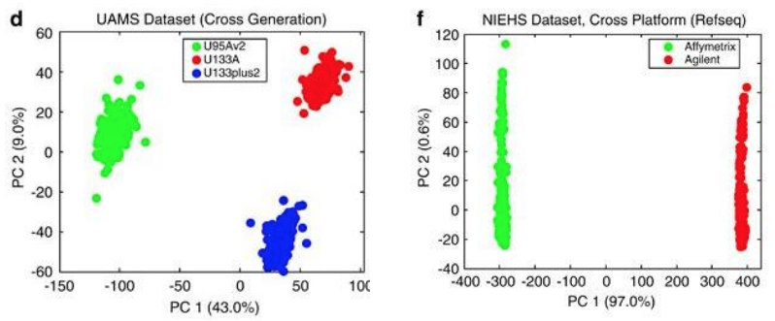
Technical Bias in expression analysis
Microarray
Luo et al., MAQC-II 2010
Notes:
One major advantage vs arrays is lower technical variance . This is array data processed on 3 different versions of the array chips on the let or two different manufactureres and you can see by principle components huge differences driven just by the array itself.

Slide 6
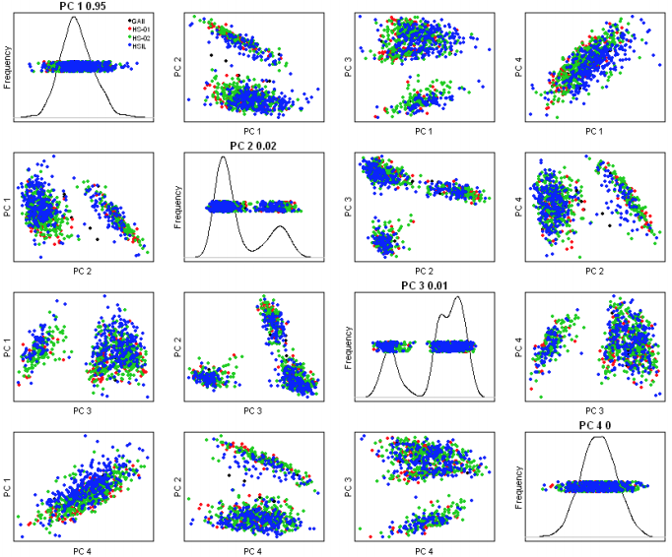
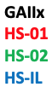
Technical Bias in expression analysis
Microarray
RNA-seq
Luo et al., MAQC-II 2010
Joel Parker
Notes:
On the right are some data I borrowed from Joel Parker’s slide on technical variation where they did RNA-seq using several different sequencing sites and this scatter plot of the principle componenets shows neraly complete overlap of the clusters - so the technical effects due to the actual machines used is pretty low.
There are still pretty serious technical or batch effects that can cause challenges, but for RNA-seq this seems to be more driven by the library prep steps rather than the sequencing step.s

Slide 7
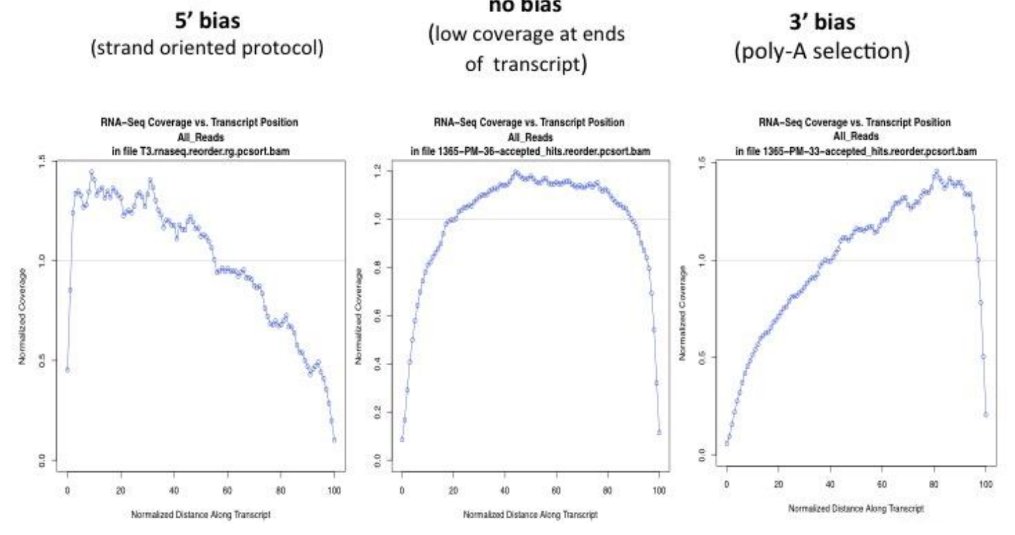
RNA-seq biases
Joel Parker

Slide 8
Practical considerations in RNA-seq processing and experimental design

Slide 9
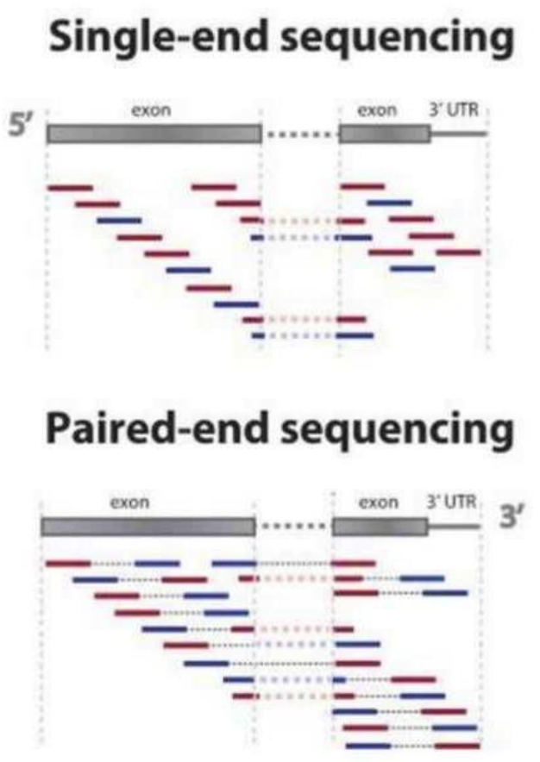
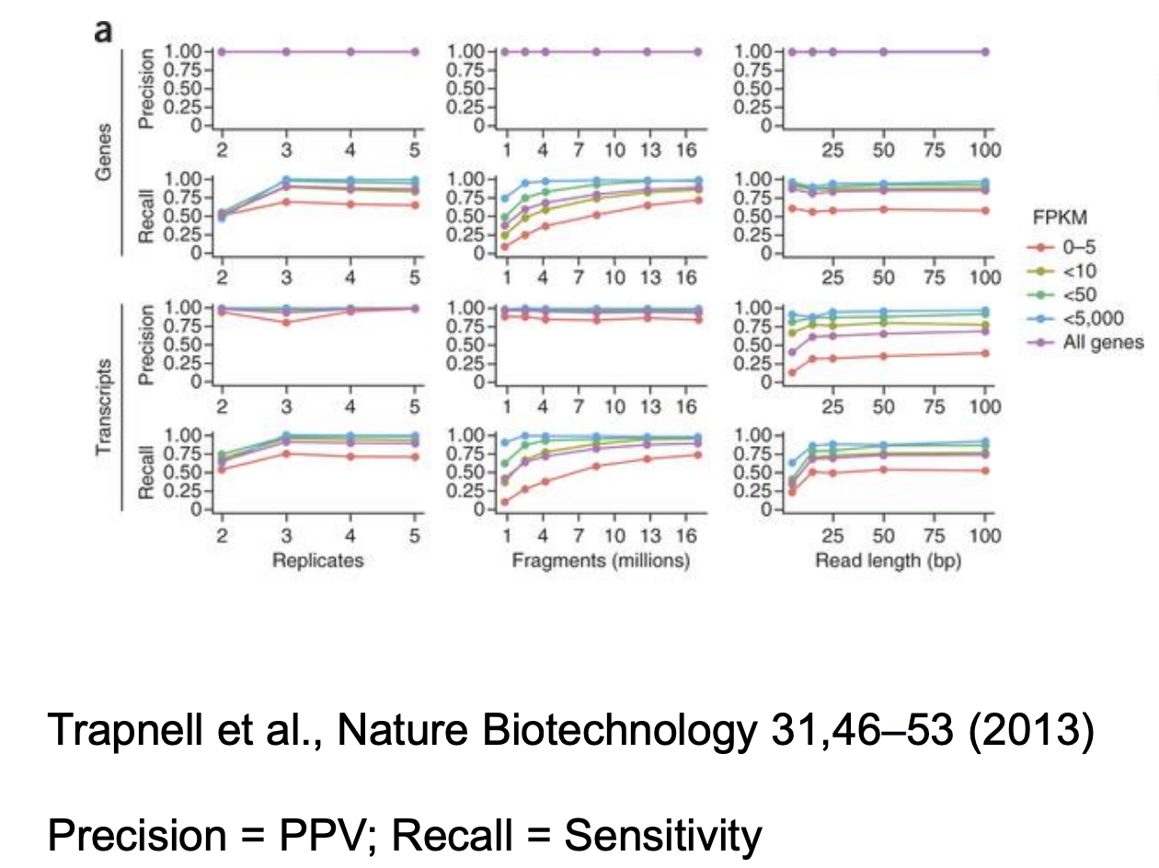
Sequencing Parameters
Key Points
> 25bp
Single end fine for DE - paired end might help mapping/splicing
Joel Parker

Slide 10
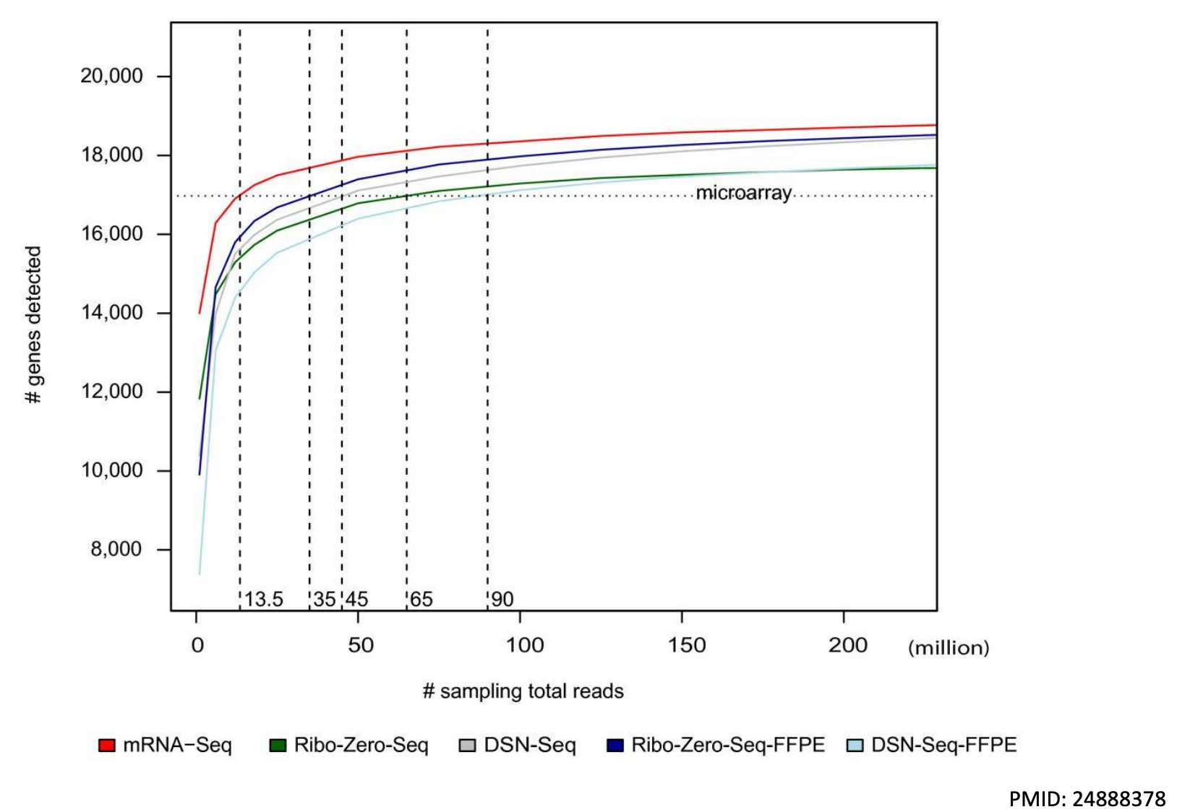
Read Depth / Sensitivity
For DE of mRNA 20-30 million, deeper if you are looking for rare transcripts/events
Library type affects needed depth
Joel Parker

Slide 11
More Depth or More Replicates
Replicates >>>>> Depth
More replicates
Liu et. al. (2014) Bioinformatics

Slide 12
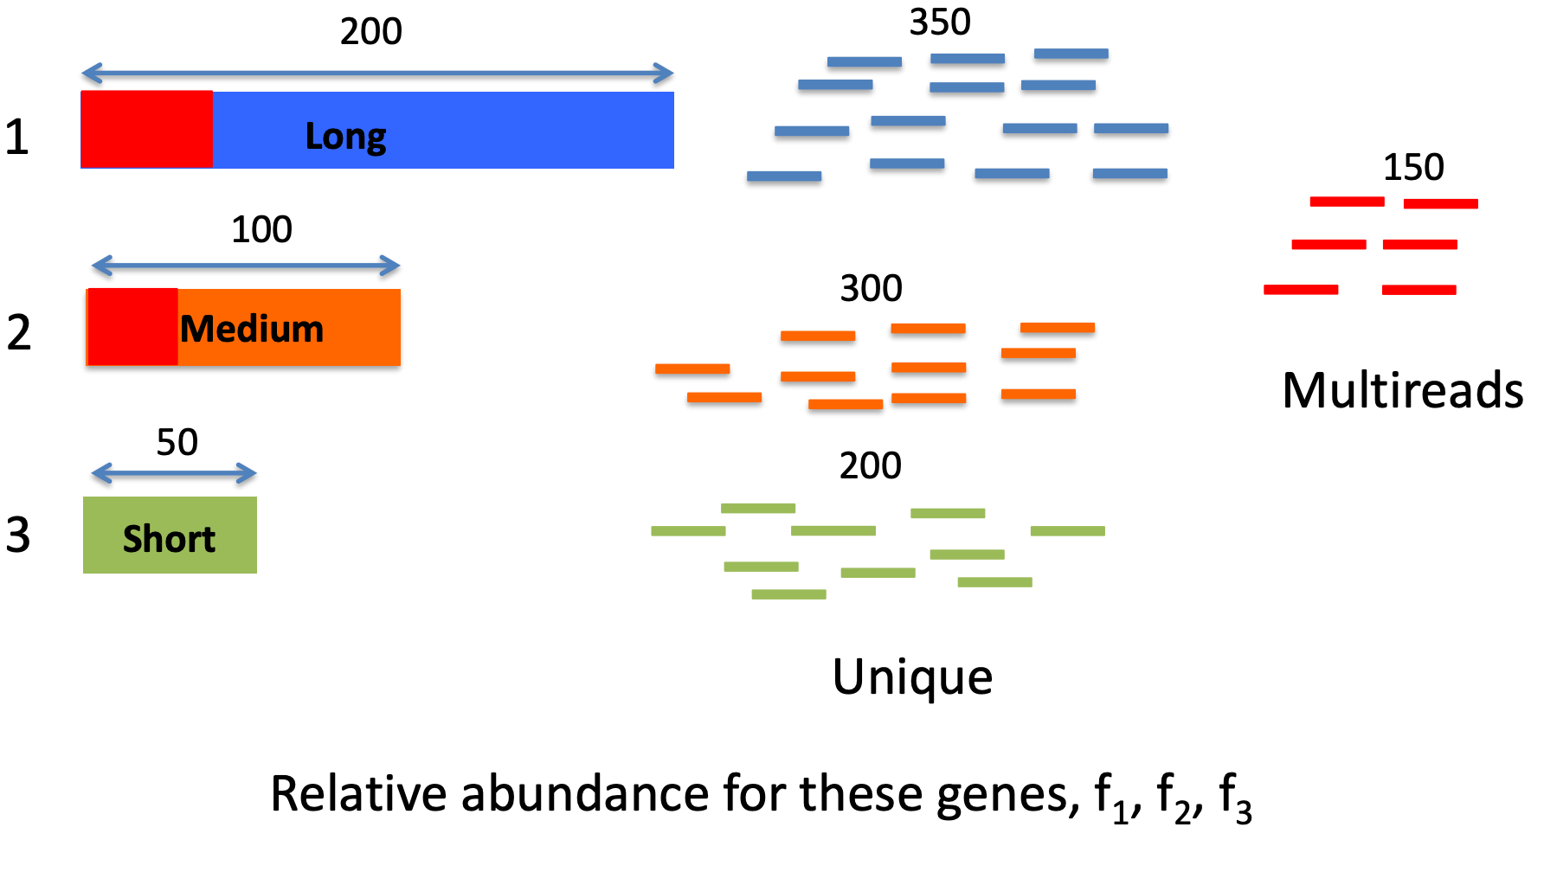
How to handle multimapping
Joel Parker

Slide 13
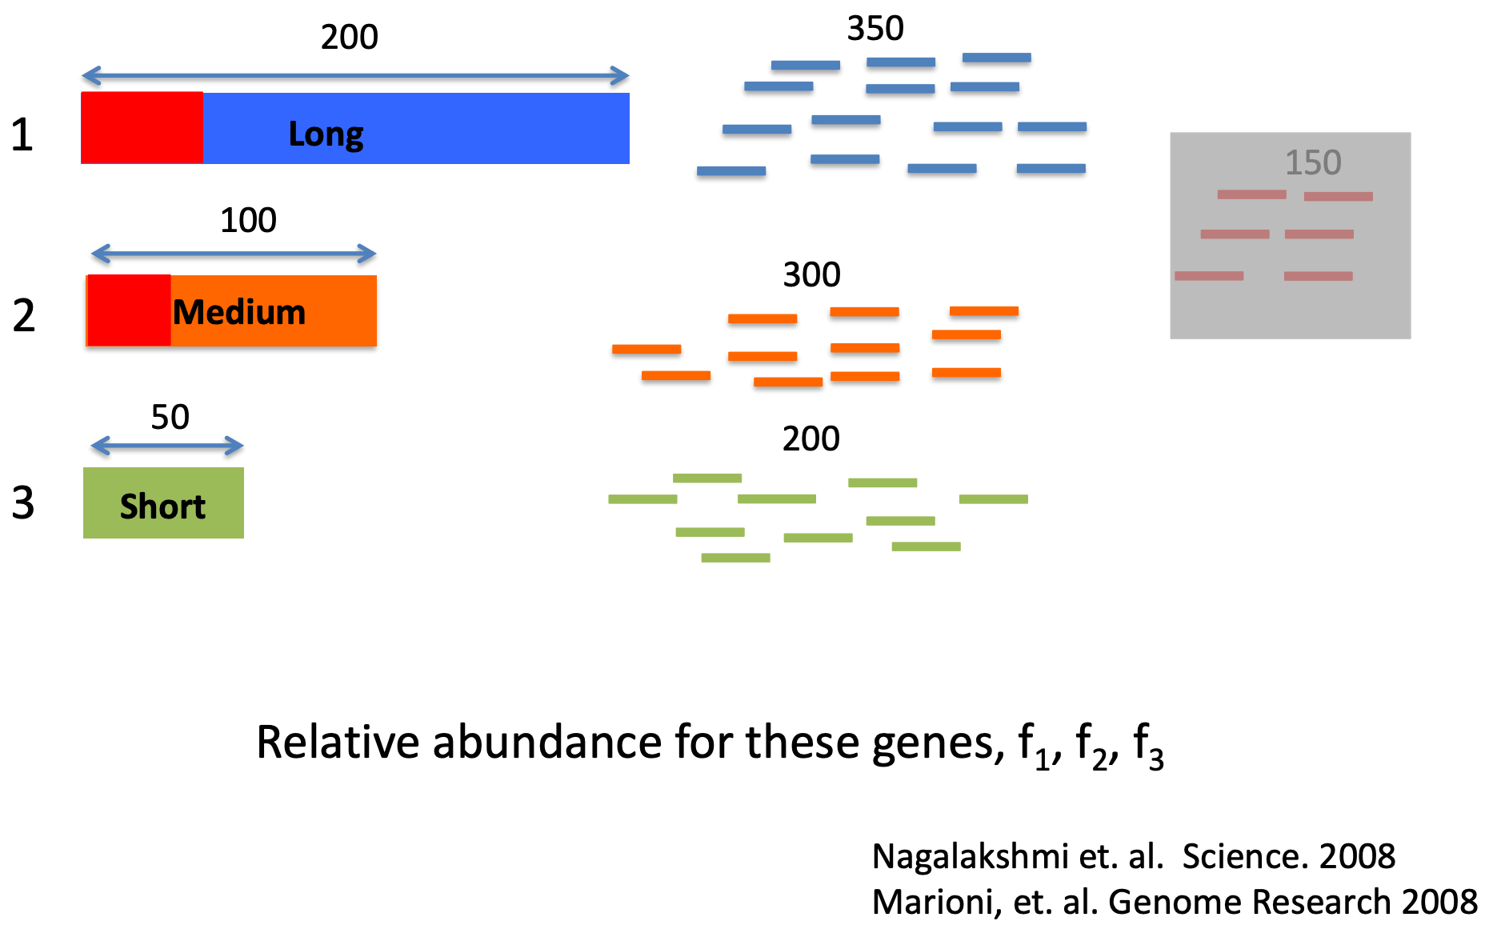
Approach 1: Ignore them
Joel Parker
Notes:
Ignoring them was the first approach but leads to a potentially seroius error (
This over-estimates the abundance of reads that are from highly unique genes - so transcript 3 here w
It understimates genes with some amount of repetitiveness.

Slide 14
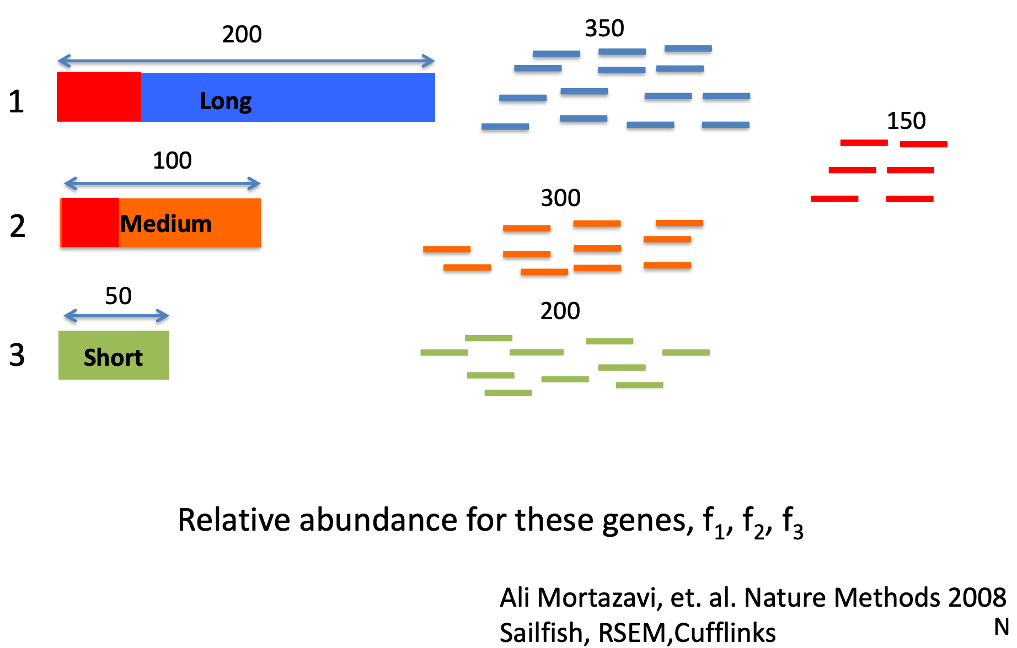
Approach 2: Fractional Allocation
Assign based on previous abundances
Joel Parker
Notes:
This is the approach that more or less has stuck and people have iterated on.
Cufflinks started by trying to figure out which transcript a multimapped read was more likely to come from by first alining unique reads and then doing a single pass step where reads were assigned based on a these prior abundancces
RSEM took this idea further by using expectation maximization steps where multiple rounds of fractional assignment were used to update the abundance estimates until you reached a convergence point. This can be pretty computationally intensive (slow and high memory usage)
Salmon/Kallisto use a streaming approach where they look at each read one at a time and assign it based no the reads already counted. THis requires that reads be randomly streamed in and not sorted somehow before. Both methods can also work without ever doing the alignment step where reads are shredded into kmers and the smaller kmers are used to exactly match transcripts which can be very fast

Slide 15

Memory Usage
Kallisto: 282 +/- 22.5, 399M
Salmon: 287.6 +/- 27.4, 339M
RSEM: 8.7, 16GB
Runtime
Kallisto: 11 + /- 3.5, 23 minutes
Salmon: 9.55 +/- 2.2, 15 minutes
RSEM: 9.1 +/- 3.5 15 hours
Joel Parker

Slide 16
Computational Processing Overview
Technical variation from sequencing is pretty small - but can be present based on library preparation strategies and batches
Raw results require significant computation processing - many approaches
Alignment : How to deal with ambiguous alignments, mapping across splice junctions, identifying new transcripts: Bowtie, Tophat, STAR, HiSat
Abundance Estimation: Gene or transcript; alignment based or alignment free, what to do with multimapping. RSEM, Cufflinks, Salmon, Kallisto, featureCounts
Normalization strategies: Total reads, upper quartile, effects of length, median ratios

Slide 17
RNA-seq Workflow
Samples
Genes
Visualization/Quality Control
Raw Counts
Differential Expression
DESeq2::vst()
DESeq2::rlog()
DESeq2::plotPCA()
DESeq2::plotCounts()
ComplexHeatmap::Heatmap()
DESeq2::DESeq()
DESeq2::results()
Package::function()
https://bioconductor.org/packages/devel/bioc/vignettes/DESeq2/inst/doc/DESeq2.html

Slide 18
RNA-seq Workflow
Samples
Genes
Visualization/Quality Control
Raw Counts
Differential Expression
DESeq2::vst()
DESeq2::rlog()
DESeq2::plotPCA()
DESeq2::plotCounts()
ComplexHeatmap::Heatmap()
DESeq2::DESeq()
DESeq2::results()
edgeR::glmFit()
edgeR::glmLRT()
edgeR::topTags()
Biological Inference
Gene set enrichment
ComplexHeatmap::Heatmap
DESeq2::plotMA

Slide 19
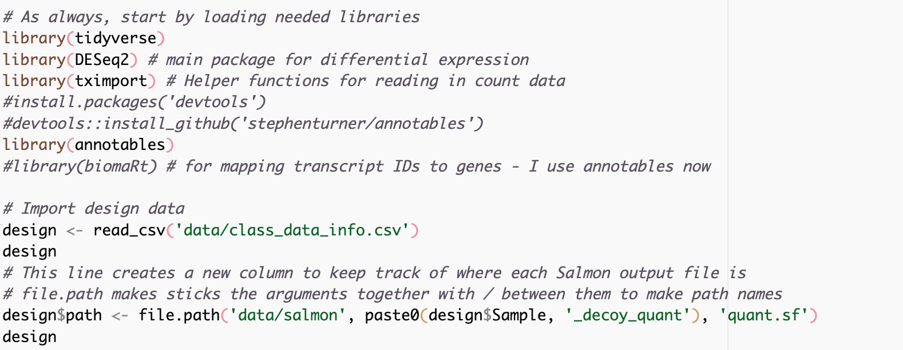
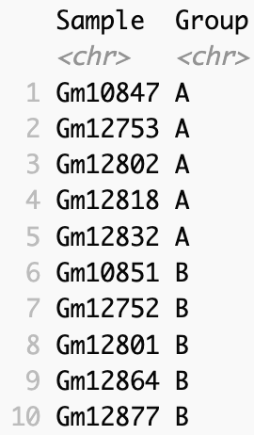
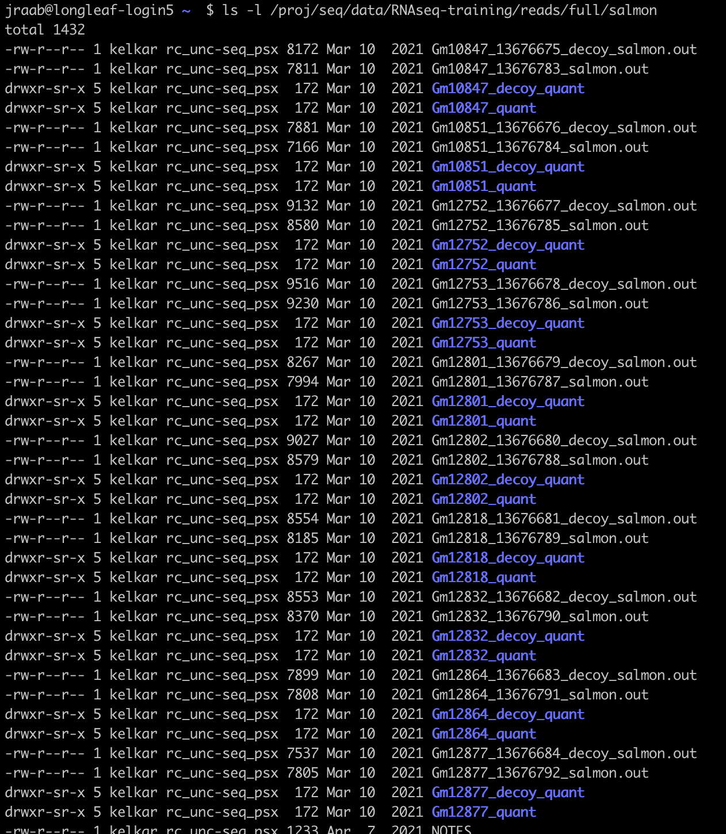
Getting your quantification data into R
These files need to be accessible on the machine you are running DESeq on
scripts/salmon_DE.R
Notes:
We use biomart to look up the annotatin mappings between ensembl’s transcript IDS and gene names (here external_gene_name) to give something I recognize when I look at the DE table.
Then we do the improt using tximport. It reads from the path we specificed, we tell it salmon did the quantification, and use tx2gene to map transcripts to genes. IgnoreTx version drops the little suffix number in the ensembl transcript id.
This gives us a list that contains a table of counts. One very important parameter is countsFromAbundance, which I Have as false. This allows scaling the counts by the transcript lengths which may change betwen conditions. If you make this True you can use the count table in txi directly - either way is fine, but I’d encourage you to be explicit in how you’ve coded this
Finally, We feed that whole thing into DESeq2 using the datasetfrommatrix call and specificy our groups using the designn = ~ Group) this is how you specificy the formula. We’ll come to more advanced formula designs in a bit, or maybe nexttime).

Slide 20
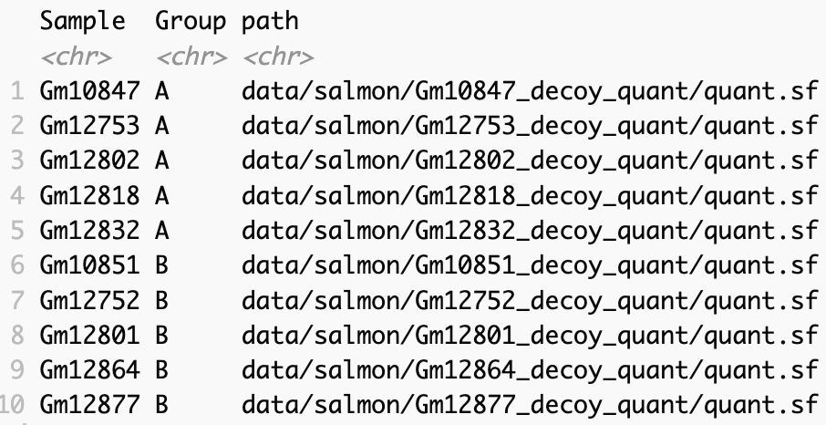

Slide 21
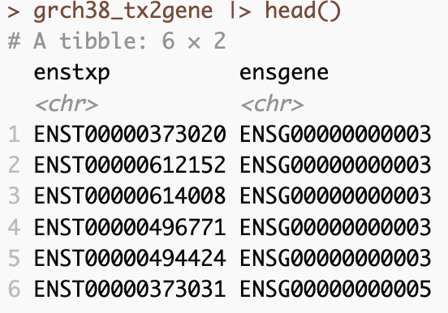
Getting your quantification data into R
Function that helps take a list of files and reads them into a count matrix.
Quant type
Summarize transcripts to genes (this is usually what I care about, but you could do transcript level DE)
Transcripts often have a trailing digit. ENST00000.1 This gets rid of that
This is the first major step
Notes:
Now we need to read those files in. I’m using a few packages from R for this, DEseq2 for its ability to make a nice summarizedExperiment object (I’ll come back to this in a few slides) , tximport is handy for reading in data from salmon and other quantification strategies. It can summarize to genes from transcripts (recall you may have more than one transcript fromt he same gene in your data set) I usually want to work at gene level and it is the simplest to do, but let your biological question the analyssi you want to do. You may care about transcript or isoform differences. Maybe you are interested in specific exon usage or that sort =of things.
We use biomart to look up the annotatin mappings between ensembl’s transcript IDS and gene names (here external_gene_name) to give something I recognize when I look at the DE table.
Then we do the improt using tximport. It reads from the path we specificed, we tell it salmon did the quantification, and use tx2gene to map transcripts to genes. IgnoreTx version drops the little suffix number in the ensembl transcript id.
This gives us a list that contains a table of counts. One very important parameter is countsFromAbundance, which I Have as false. This allows scaling the counts by the transcript lengths which may change betwen conditions. If you make this True you can use the count table in txi directly - either way is fine, but I’d encourage you to be explicit in how you’ve coded this
Finally, We feed that whole thing into DESeq2 using the datasetfrommatrix call and specificy our groups using the designn = ~ Group) this is how you specificy the formula. We’ll come to more advanced formula designs in a bit, or maybe nexttime).

Slide 22
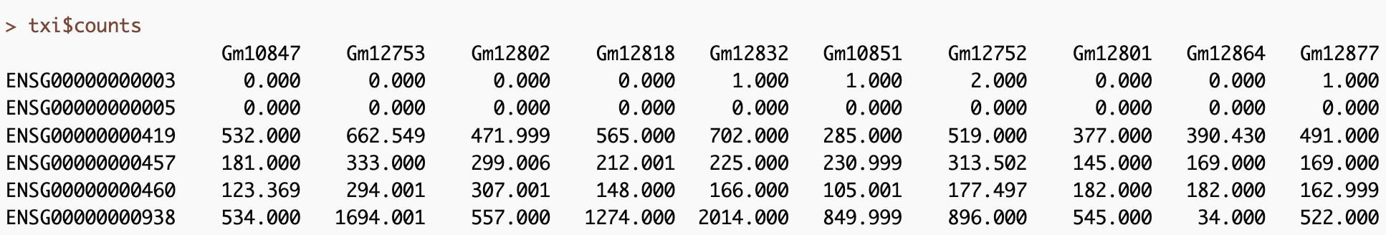
Put back column names because they are lost when importuning. I use the sample information to do this

Slide 23
Major Step 2 – Make the DESeq Data set (dds)
Function to create dataset
Txi object or counts
Sample or column data for summarizedExperiment
Experimental design

Slide 24
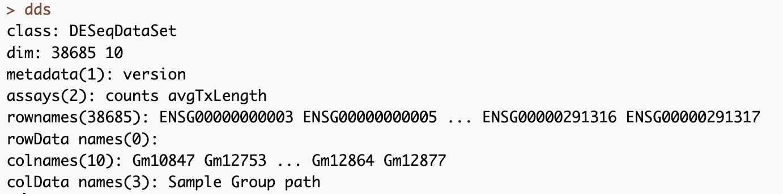
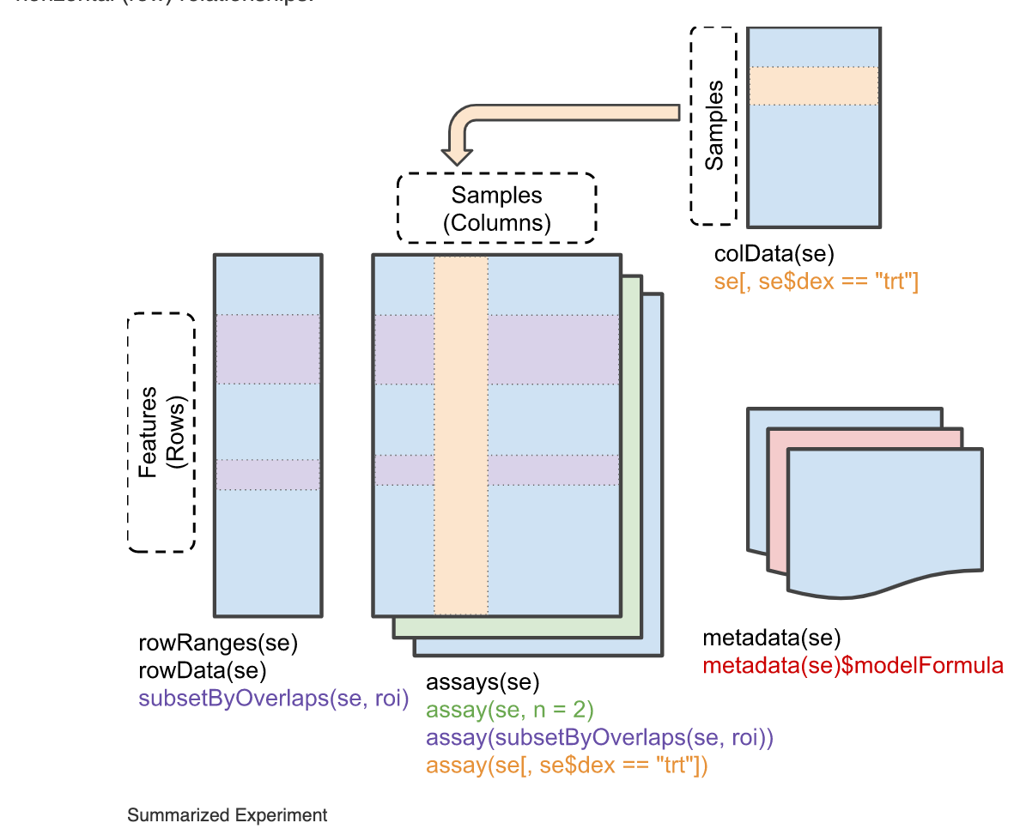
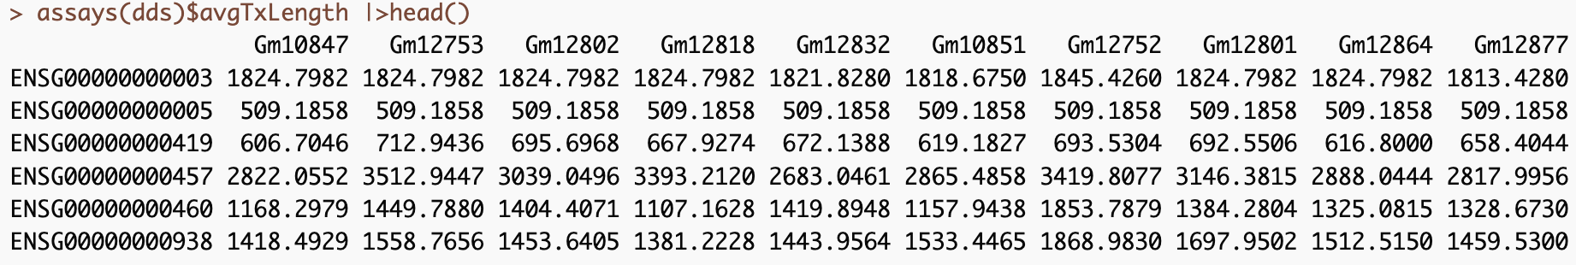
Major Step 2 – Make the DESeq Data set (dds)

Slide 25
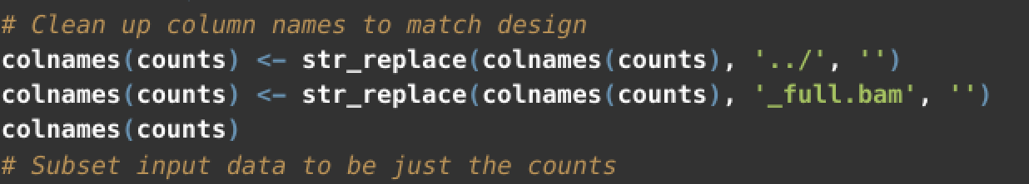
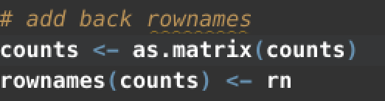
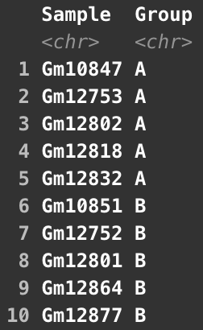
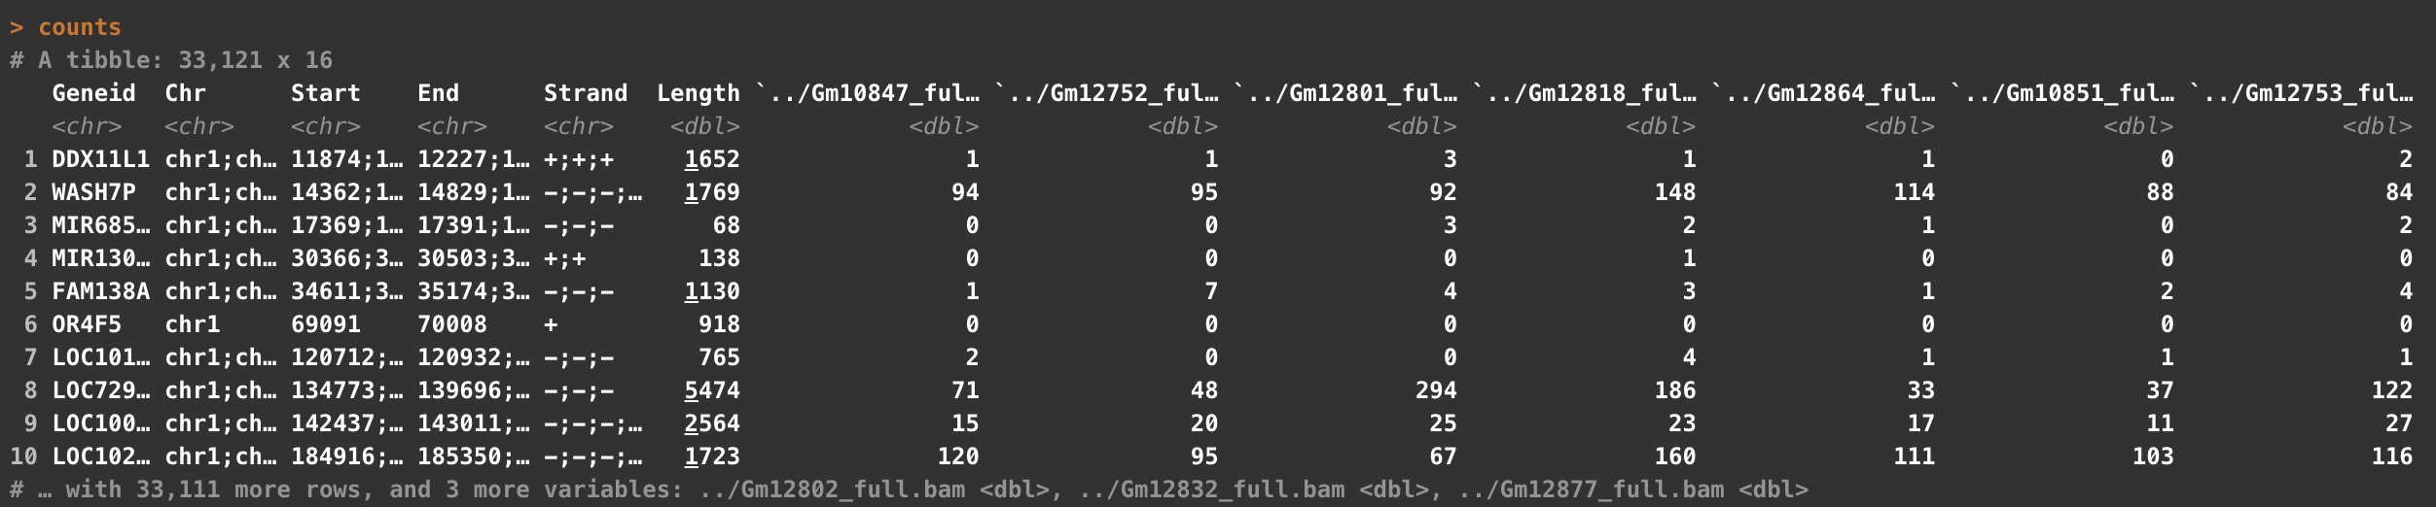
Alternatively - if you use a tool like featureCounts or already have a count matrix
Can also use janitor::clean_names()
Samples
Count Matrix
Notes:
You could do similarly iwth any matrix of count data you have. This is an example of how I’d do it for quantitation data from featureCounts. You can read that table in directly, but the first 6 columns describe some information about the annotations we used to quantify. I really only want the geneid here, so I keep that as an additional variable, and make the rest a matrix. I do a little bit int he middle to clean up the column names so that my column names and the Sample names in my design table match (AND ARE IN THE SAME ORDER)

Slide 26
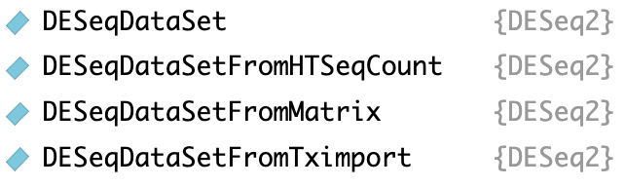
Additional functions for reading in data to a DESeqDataSet

Slide 27
Goals in RNA-seq Analysis
Samples
Genes
Raw Counts
Visualization/Quality Control
Differential Expression
DESeq2::vst()
DESeq2::rlog()
DESeq2::plotPCA()
DESeq2::plotCounts()
ComplexHeatmap::Heatmap()
DESeq2::DESeq()
DESeq2::results()
R code for Differential Expression
Full annotated methods in salmon_DE.R
Notes:
So now that we have our data into a DESeq object we can do either of these two paths, and we need to do both. I’m going use the time we have left to show some visualization/quality control things about our data.
Next time we’ll do the differenetial expression side, work through that code and talk about what DESeq is actually doing

Slide 28
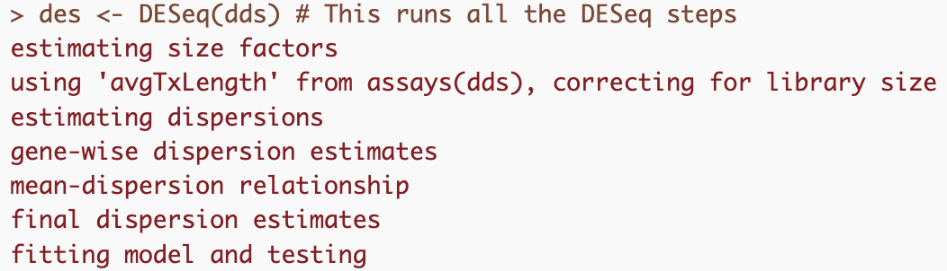
Goals in RNA-seq Analysis
Samples
Genes
Differential Expression
Raw Counts
DESeq2::DESeq()
DESeq2::results()
estimateSizeFactors
estimateDispersions
GLM fit for each gene
edgeR::glmFit()
edgeR::glmLRT()
edgeR::topTags()

Slide 29
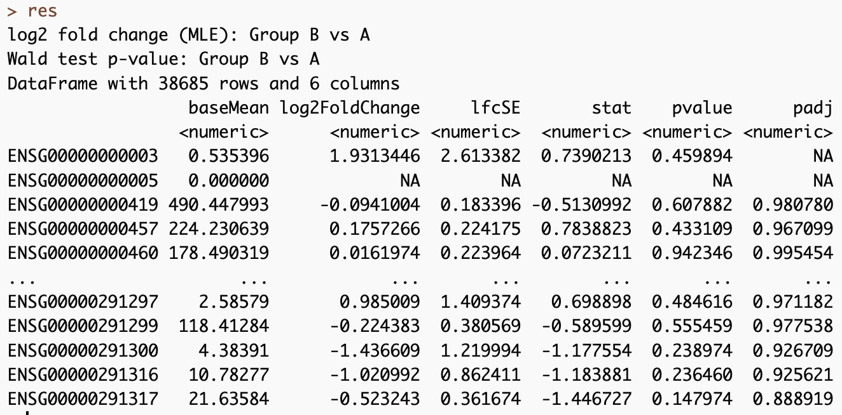
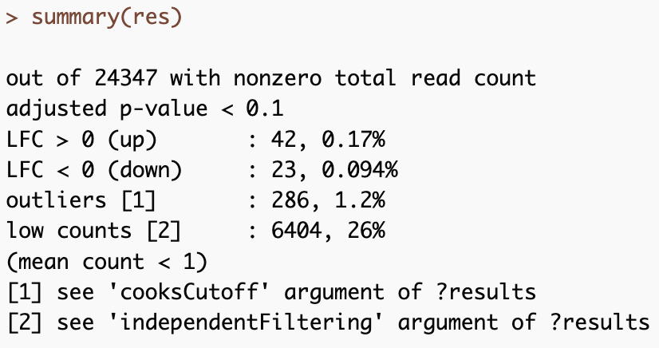
Goals in RNA-seq Analysis
Samples
Genes
Differential Expression
Raw Counts
DESeq2::DESeq()
DESeq2::results()
Wald Test (Default)
Likelihood Ratio Test
edgeR::glmFit()
edgeR::glmLRT()
edgeR::topTags()
Notes:
Choosing between these tests is a little confusing ( I generally have to look this up when I’m doing something more complicated thanusual).
Wald test works well when you are doing pairwise comparisons - so what chagnes change between drug and vehicle treatmentes. pvalues here are telling you whch fold changes are significantly different.
LRT tests are appropriate for timecourse of if you want to analyze all levels of a factor at once. Say for example you have drug a drug b drug c and vehicle and you want to see which genes change - here the pvalue tells you that including your treatment condition in the model provides value to the model, it doesn’t relate to a specific lfc comparison.

Slide 30
You could run these steps independently
DESeq()
Estimate size factors
estimateSizeFactors()
Estimate dispersion
estimateDispersion()
Fit negative binomial GLM
nbinomWaldTest()
nbinomLRT()

Slide 31
DESeq Results
des <- DESeq(dds)
Estimate Size Factors
What are size factors?
Generate a reference sample from the geometric mean of all samples
Estimate gene-wise dispersions
Get ratio of each sample to that ‘reference’
Fit curve to dispersion estimates
Shrink gene-wise dispersion estimates
GLM for each gene

Slide 32
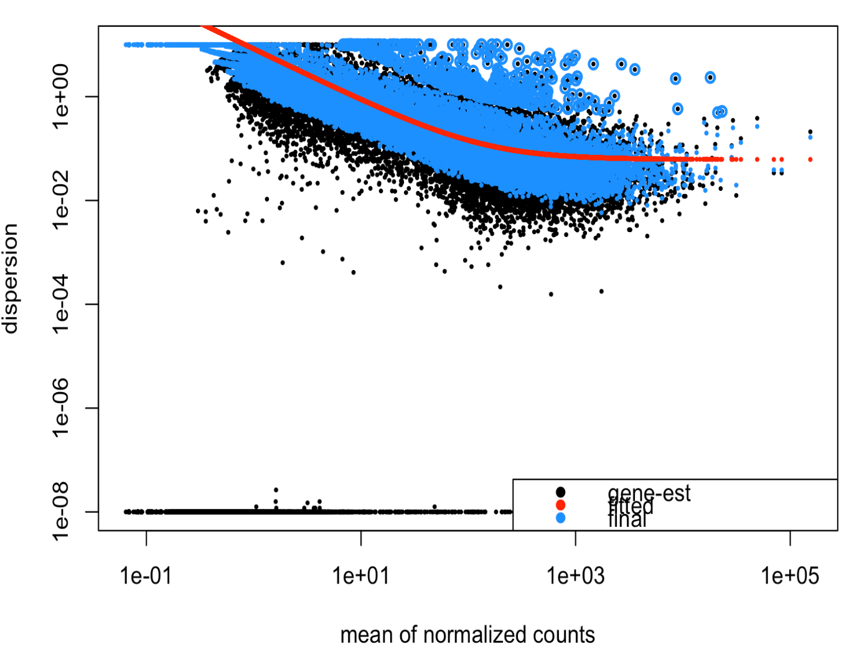
DESeq Results
des <- DESeq(dds)
Estimate Size Factors
Estimate gene-wise dispersions
Fit curve to dispersion estimates
Shrink gene-wise dispersion estimates
GLM for each gene

Slide 33
DESeq Results
des <- DESeq(dds)
Estimate Size Factors
Estimate gene-wise dispersions
Fit curve to dispersion estimates
Shrink gene-wise dispersion estimates
GLM for each gene
What is this fit doing?

Slide 34
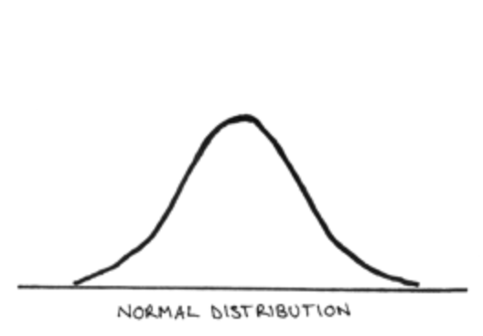
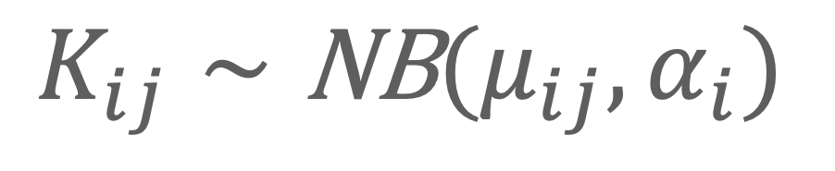
DESEq Theory
$$K_{ij}∼\text{NB}(μ_{ij},α_{i})$$
Observed Counts
Mean
Dispersion
Notes:
A really deep understanding of the model here I don’t think is necessary, but its good to have a little understanding of why we use this model and approach for RNA seq. This formula essentially is saying we are modeling the count data (K) for the ith gene in the jth sample from a binomial distribution. This binomial distribution has two parameters, the mean and the dispersion. We use negative binomal instead of say, the normal distribution becaues as what we are measuring is count data, it can’t be normally distributed,we cant have -3 reads for example. Count data can be measured with a Poisson distributiojn,b ut this assumes that variance does not change with the mean. As we talkea bout last time, genes with low counts have high dispersion so we see dependece on expression level.

Slide 35
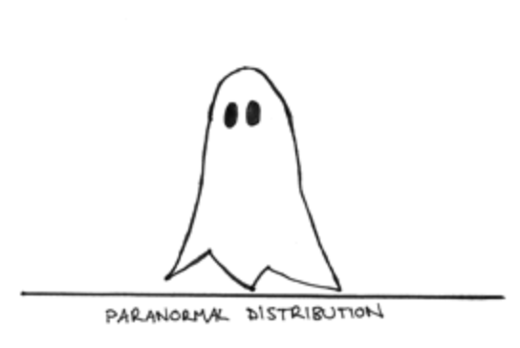
DESEq Theory
$$K_{ij}∼\text{NB}(μ_{ij},α_{i})$$
Observed Counts
Mean
Dispersion
https://www.statisticshowto.com/negative-binomial-experiment/
Notes:
A really deep understanding of the model here I don’t think is necessary, but its good to have a little understanding of why we use this model and approach for RNA seq. This formula essentially is saying we are modeling the count data (K) for the ith gene in the jth sample from a binomial distribution. This binomial distribution has two parameters, the mean and the dispersion. We use negative binomal instead of say, the normal distribution becaues as what we are measuring is count data, it can’t be normally distributed,we cant have -3 reads for example. Count data can be measured with a Poisson distributiojn,b ut this assumes that variance does not change with the mean. As we talkea bout last time, genes with low counts have high dispersion so we see dependece on expression level.

Slide 36
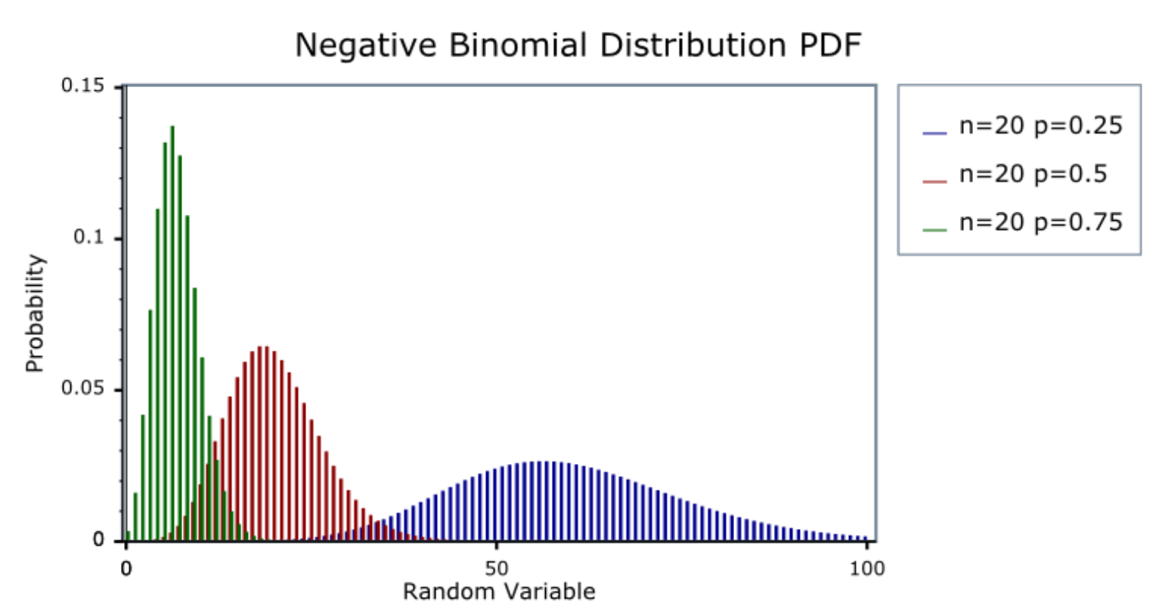
DESEq Theory
$$K_{ij}∼\text{NB}(μ_{ij},α_{i})$$
Observed Counts
Mean
Dispersion
https://www.statisticshowto.com/negative-binomial-experiment/
Notes:
A really deep understanding of the model here I don’t think is necessary, but its good to have a little understanding of why we use this model and approach for RNA seq. This formula essentially is saying we are modeling the count data (K) for the ith gene in the jth sample from a binomial distribution. This binomial distribution has two parameters, the mean and the dispersion. We use negative binomal instead of say, the normal distribution becaues as what we are measuring is count data, it can’t be normally distributed,we cant have -3 reads for example. Count data can be measured with a Poisson distributiojn,b ut this assumes that variance does not change with the mean. As we talkea bout last time, genes with low counts have high dispersion so we see dependece on expression level.

Slide 37

DESEq Theory
$$K_{ij}∼\text{NB}(μ_{ij},α_{i})$$
Observed Counts
Mean
gene-specific dispersion
$$μ_{ij}=s_{j}q_{ij}$$
Size Factor
Concentration of fragments
in sample
https://www.bioconductor.org/help/course-materials/2015/CSAMA2015/lect/L05-deseq2-anders.pdf
Notes:
A really deep understanding of the model here I don’t think is necessary, but its good to have a little understanding of why we use this model and approach for RNA seq. This formula essentially is saying we are modeling the count data (K) for the ith gene in the jth sample from a binomial distribution. This binomial distribution has two parameters, the mean and the dispersion. We use negative binomal instead of say, the normal distribution becaues as what we are measuring is count data, it can’t be normally distributed,we cant have -3 reads for example. Count data can be measured with a Poisson distributiojn,b ut this assumes that variance does not change with the mean. As we talkea bout last time, genes with low counts have high dispersion so we see dependece on expression level.

Slide 38
Hypothesis Testing
Wald: (default) - Is the LFC == 0 (null)
LRT (two or more classes) : Does the full model add anything to the fit
e.g full model ~ Group
reduced model ~ 1 (intercept)
Notes:
Wald does this by taking LFC and dividing by SE to get a z-statistic which is compared to the normal distribution to get a p-value ( the liklihood of observing this or a more extreme statistic if the null were tru)
LRT tells you if there is any difference between the condition of interst, the LFC values are not informative though. You can extract individual comparisons using Wald tests -we will go into more depth about different formula and extracting meaning from these tests next time.

Slide 39
Lecture 4
Recap
More replicates more important than more reads/sample
20-30 million/sample
How to import Salmon data in R (tximport)
Make a DESeqDataset (DESeqDataSetFromTximport)
Calculate differentially expressed genes (DESeq)
Full annotated methods in salmon_DE.R

Slide 40
Goals in RNA-seq Analysis
Samples
Genes
Raw Counts
Visualization/Quality Control
Differential Expression
DESeq2::vst()
DESeq2::rlog()
DESeq2::plotPCA()
DESeq2::plotCounts()
ComplexHeatmap::Heatmap()
DESeq2::DESeq()
DESeq2::results()
edgeR::glmFit()
edgeR::glmLRT()
edgeR::topTags()
Biological Inference
Gene set enrichment
ComplexHeatmap::Heatmap
DESeq2::plotMA

Slide 41
DESeq Code

Slide 42
Quality Control and Data Visualization
Do experimental groups look right
Does number of reads makes sense
Do replicates cluster together
Are there potential batch effects/biases

Slide 43
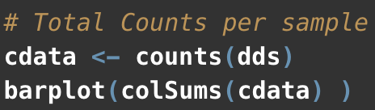
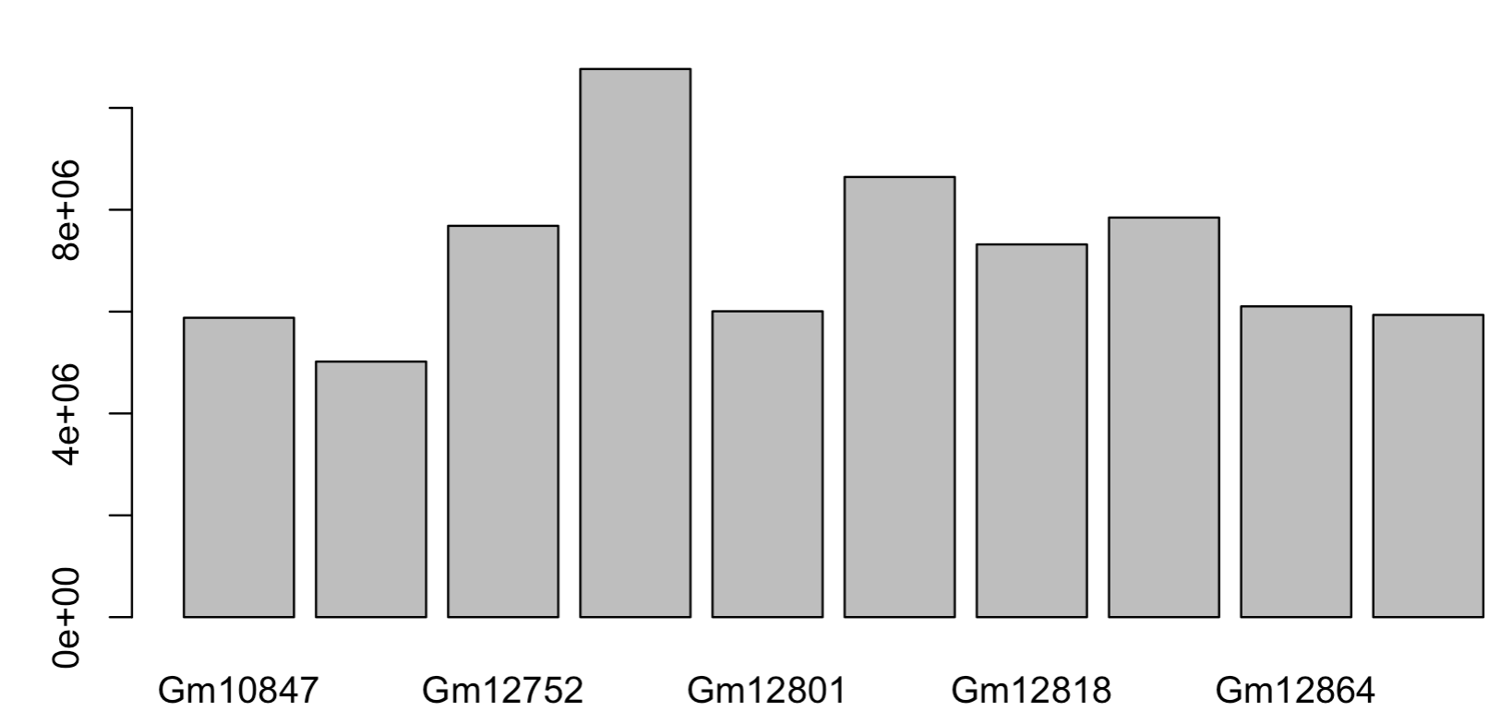
Total counts per sample

Slide 44
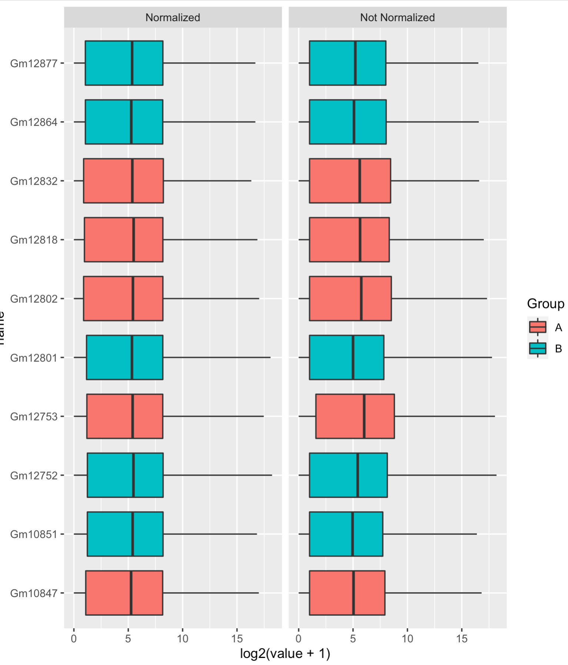
Normalized using DESeq
Notes:
Trrying to evaluate if there are any imbalances in the data or groups we should take note of.
On the right side is the non-normalized raw count data (this will be the input do DESEq analysis next time). The left side is normalized data where we’ve taking the count matrix back out of the DESeq object and normalized it using the sizefactors DESeq estmiates.
This is probably not the best way to do this, and DESeq includes two better approaches rlog and vst which are useful when you want to do clustering or anything related to distances between samples.

Slide 45
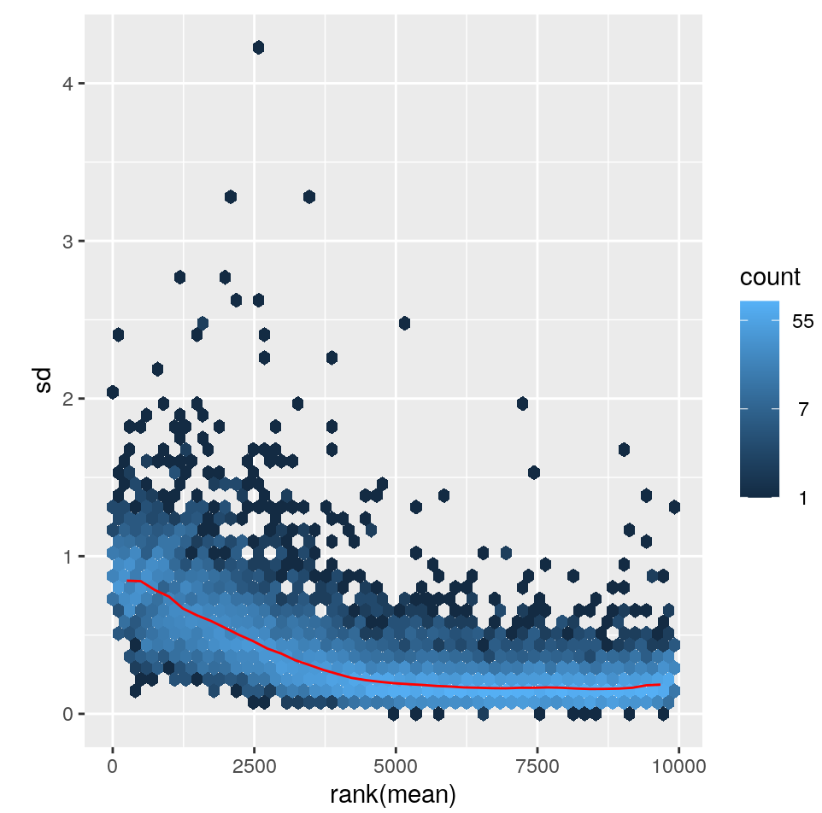
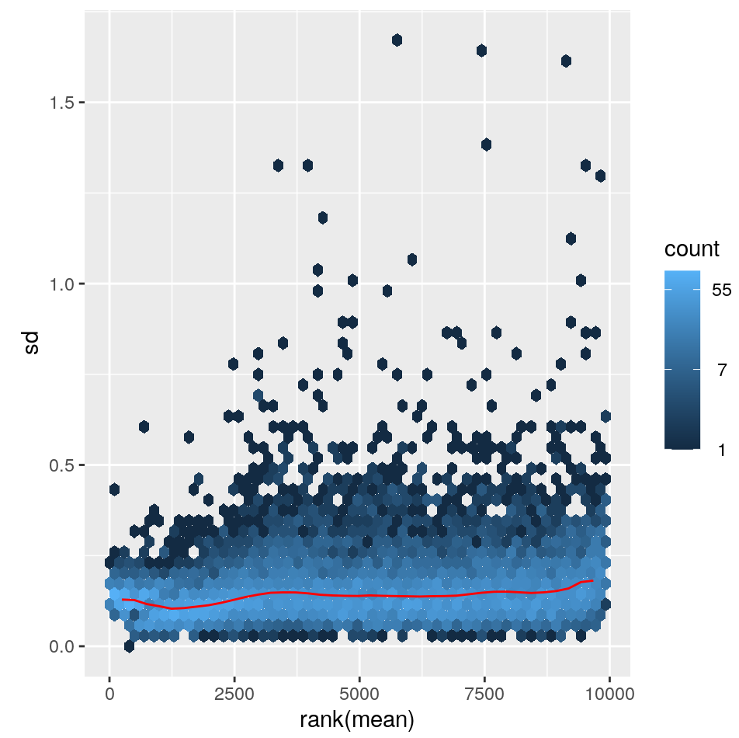
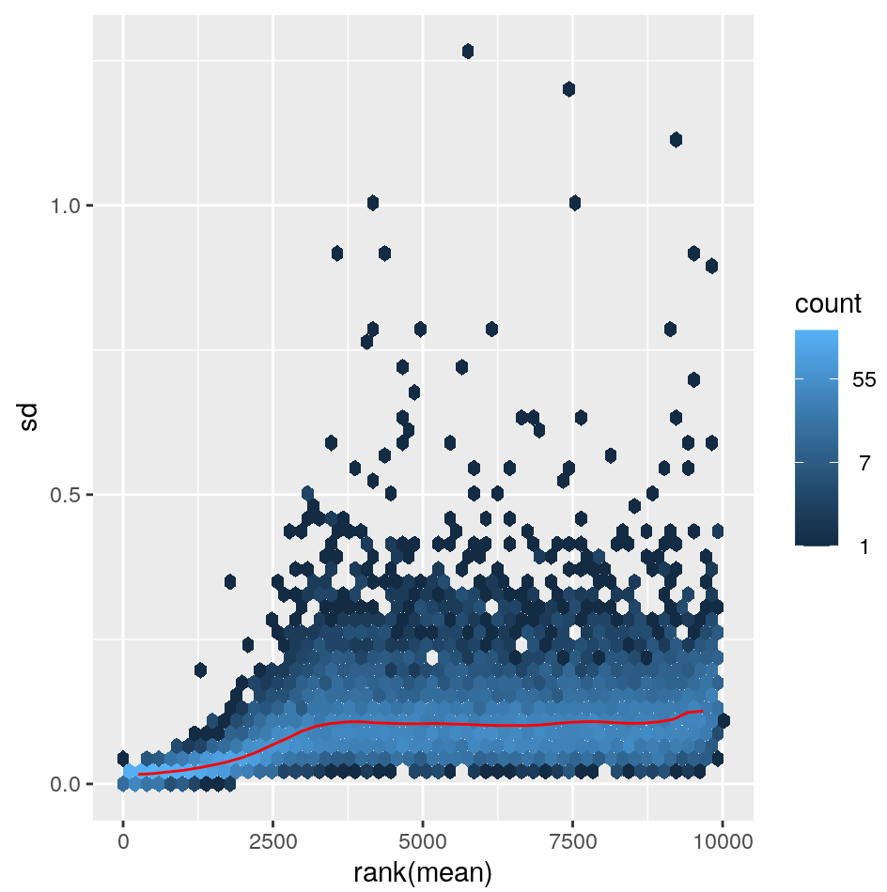
Data transformations
Log2(n+1)
vst
rlog
https://bioconductor.org/packages/release/bioc/vignettes/DESeq2/inst/doc/DESeq2.html#data-transformations-and-visualization
Notes:
One problem we are trying to solve with normalization approaches is correting for library size - the other major problem is that the variance of a gene depends on its mean. I took these plots from the DESEq2 manual at the bottom.
bThis means that low expressed genes have high standard deviations of expresion. Ideally you’d want to have constant variation across expression range. The first plot is just the log2 value of the counts. You can see low expressed genes have higher standard deviations.
VST fixes this and you get relatively constant sd across the expression range
Rlog also flattens this in the low end, but possibly a bit too much. I think both vst and rlog are likely appropriate for most analyes, but vst is a little faster.

Slide 46
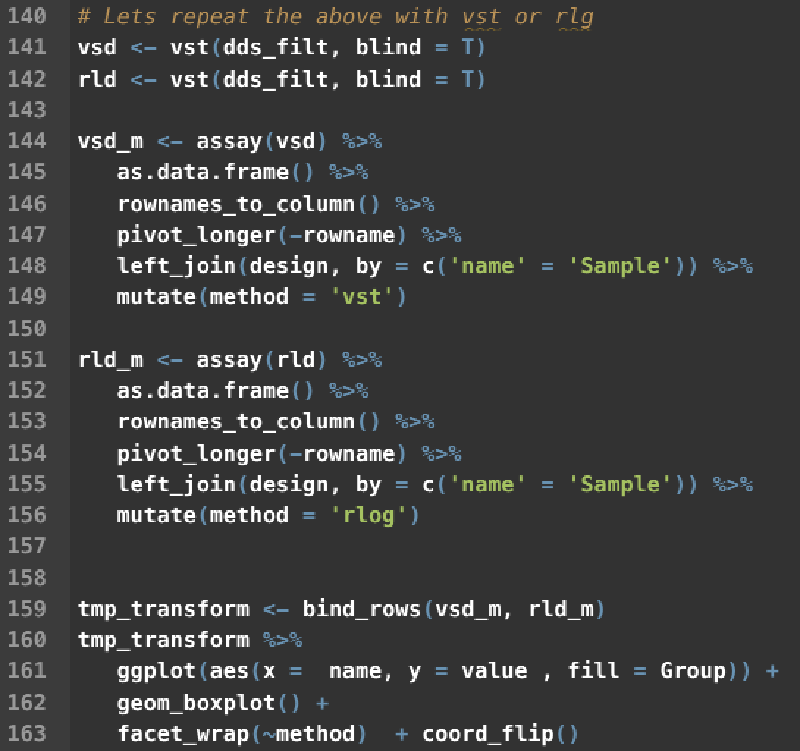
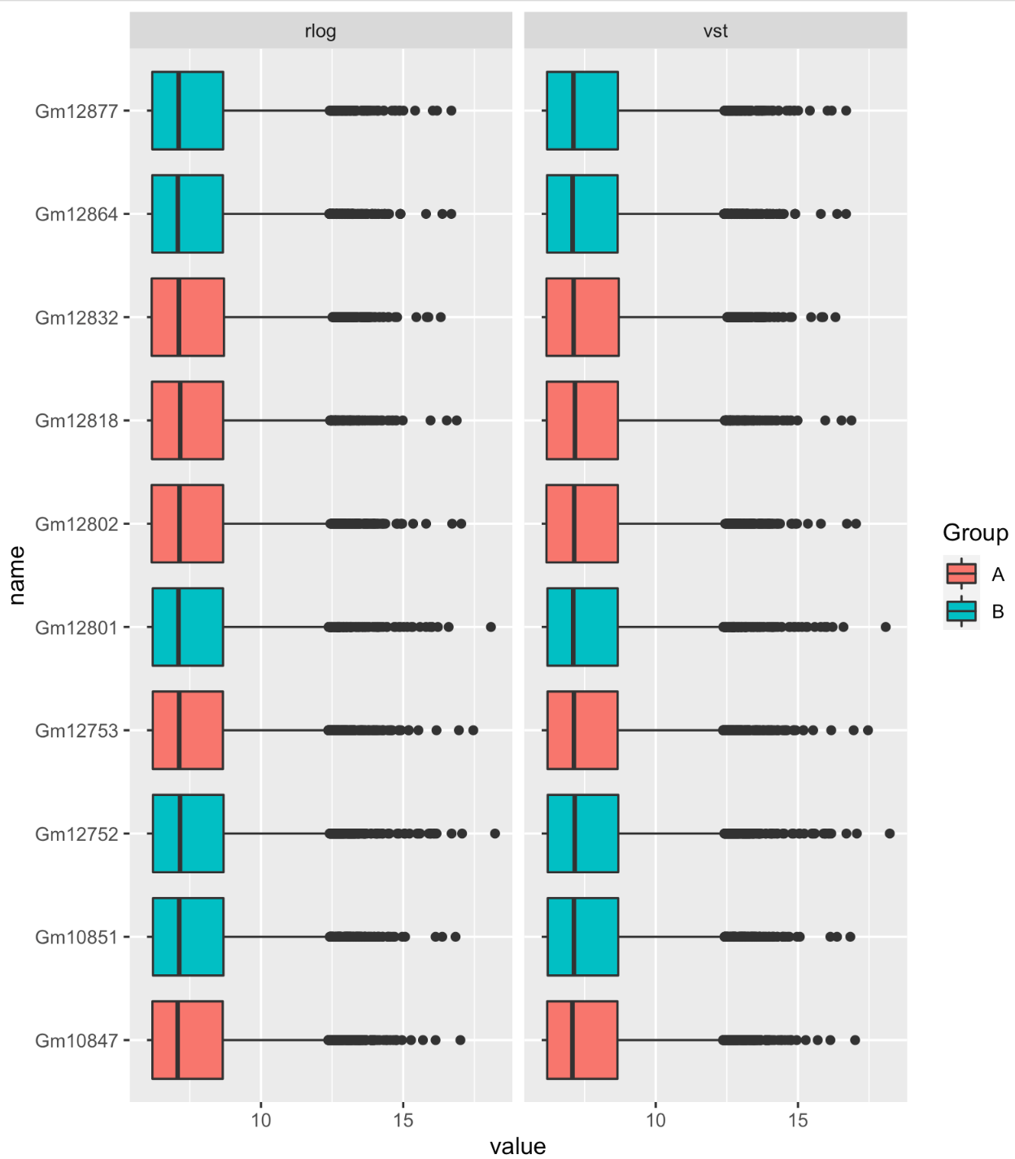
vst and rlog transformations
Notes:
These functions are described well int he DESeq documentation, both do roughly equivalent things, vst is faster and is the one I usually use.
Walk through code -
SO you can see for both vst and rlog the normalzied data look relatively simialr and there are not obvious gorup differences remaining after this transformation. That doesn’t mean there are no biases or batch effects, but nothing very obvious jumps out to me here.

Slide 47
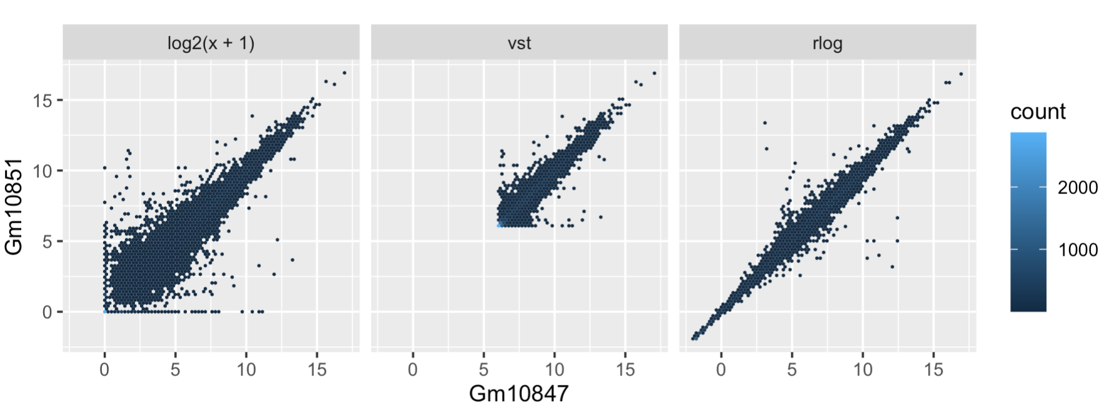
A better way - rlog and VST
Sample2
Sample1
Sample1
At low expression
Noise is dominating
Better,
shifts expression of lower expressed genes
Shrinks low counts
Notes:
We can compare two samples using these plots as well. This also comes form the DESEq2 manual. Here we are comparing two samples that we’ve transformed using one of the three prevouis methods
I think you can really appreciate how noisy the shifted log version is - the low values are just all over the place due to noise of counting those weakly expressed genes.
vst is faster and maybe is then better for bigger data sets,but might be a bit more sensitive to outliers. - while rlog might work a bit better on small datasets, but isn’t as good if you have a huge range of sequencing depth (like more than an order of magnitude)
You can try both but they should give relatively similar results
These are important as the variance of your data will increase as the mean does. These variances will dominate princple components and other visualization methods.

Slide 48
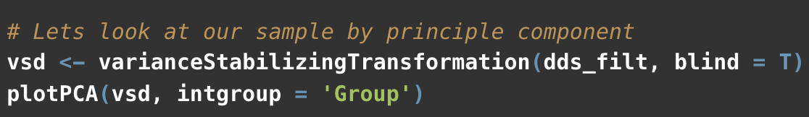
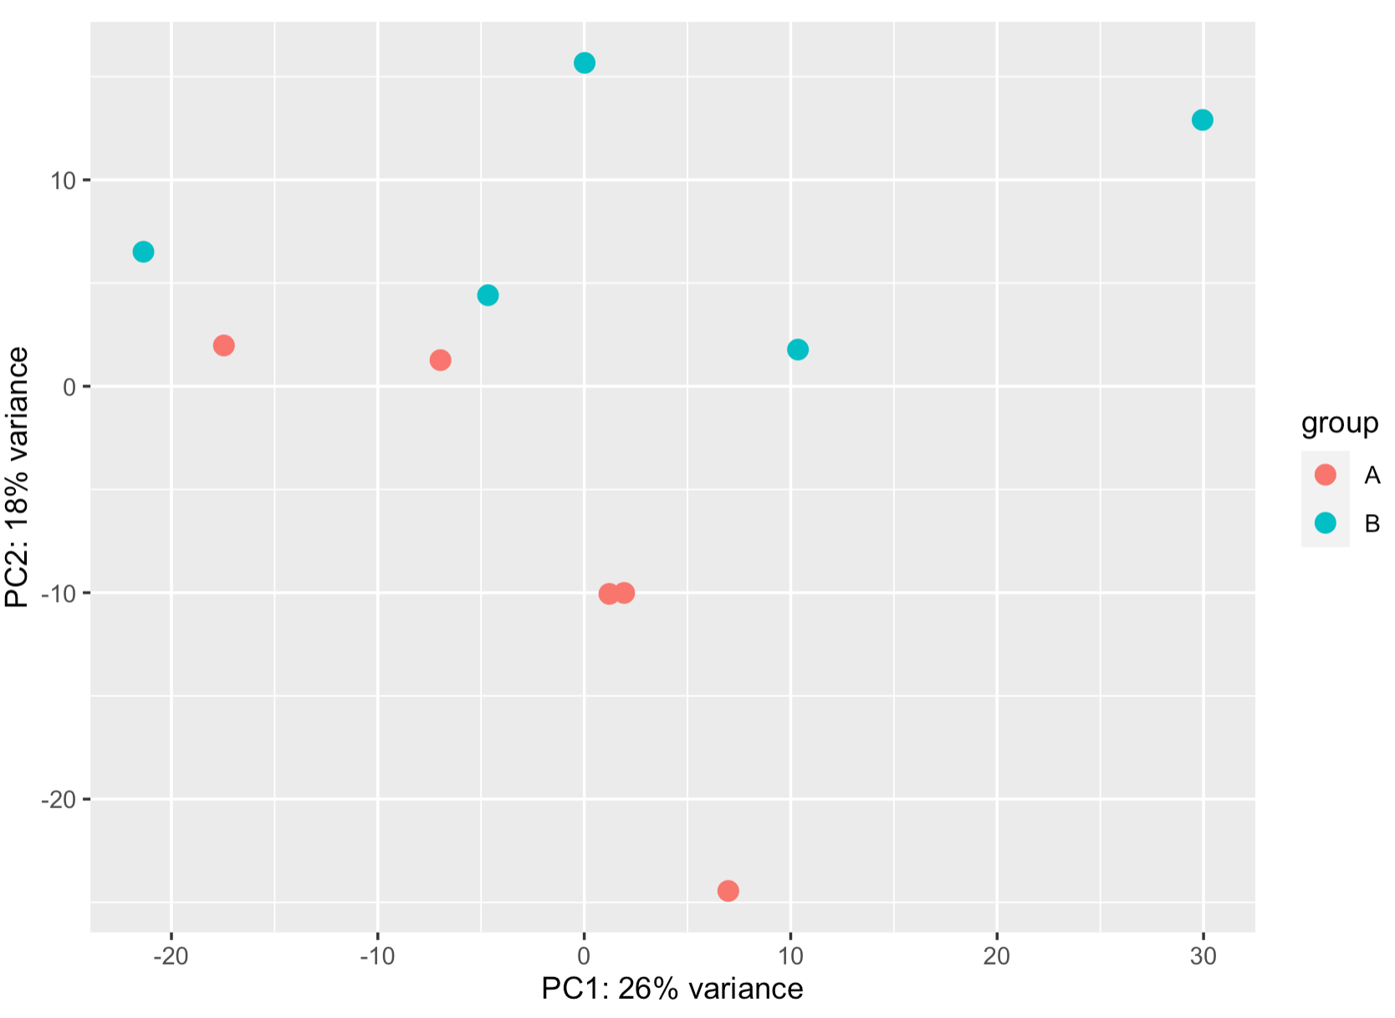
blind = T

Slide 49
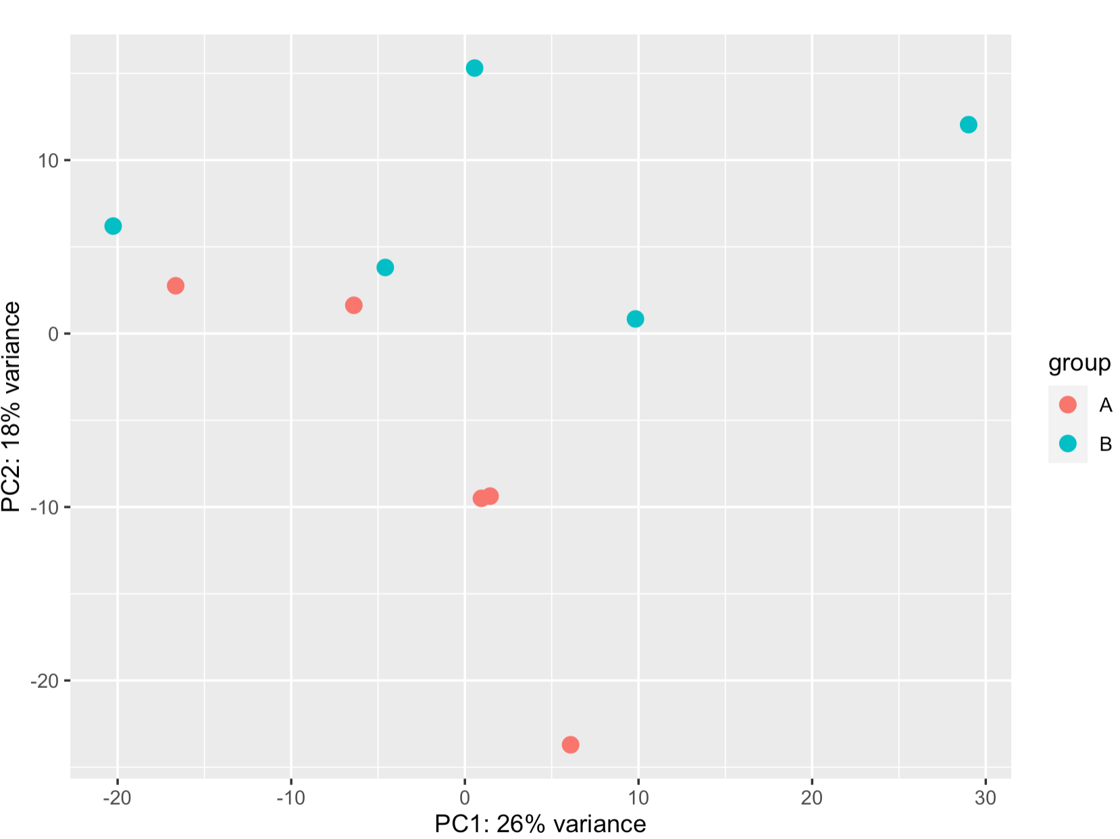
blind = T
blind = F

Slide 50
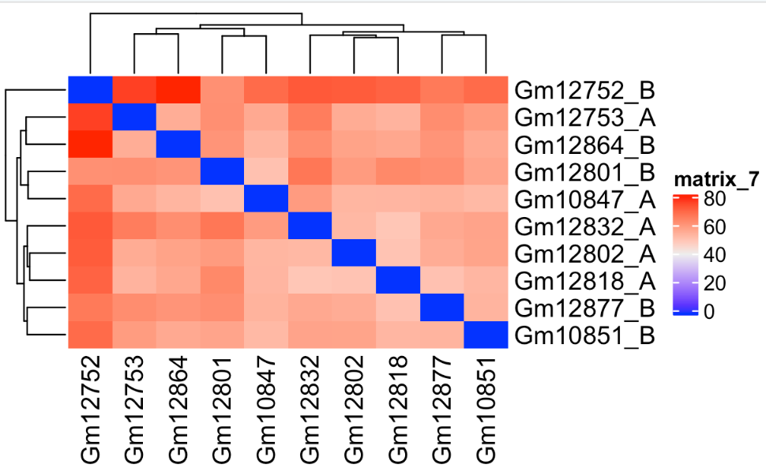
Sample Clustering
Notes:
What you’re looking for hear is that samples cluster based on replciates. Pretty clearly we aren’t getting very good cluster separeation. Next time we’ll look for hidden batch effects to see if that can improve clustering - and then move on to DE analysis.

Slide 51
R code for QC

Slide 52
Lecture 3

Slide 53
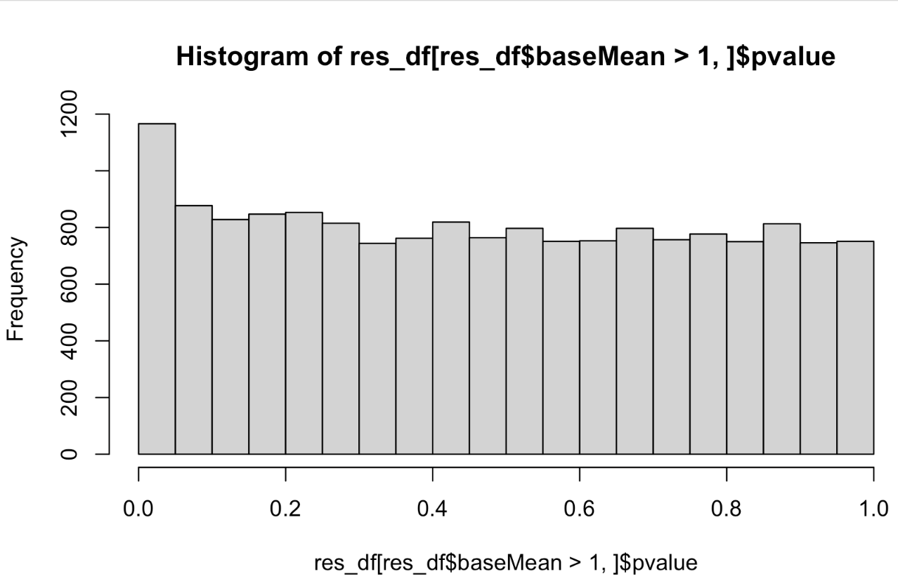
P-values
Notes:
some of these are just by chance - you can sort of look at th edistrubtion and assume at least ~800 of them are, but there could be a few hundred p-values that really are - we use an correction for multiple testing to find these.
Default here is false discovery rate (benjami hochberg) -or the proportion of false discoveries - so with an FDR of 0.1, we expect ~10% of the rejected null hypothesis to be an error, and to actually be just due to chance.

Slide 54
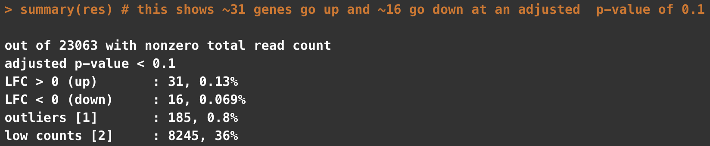
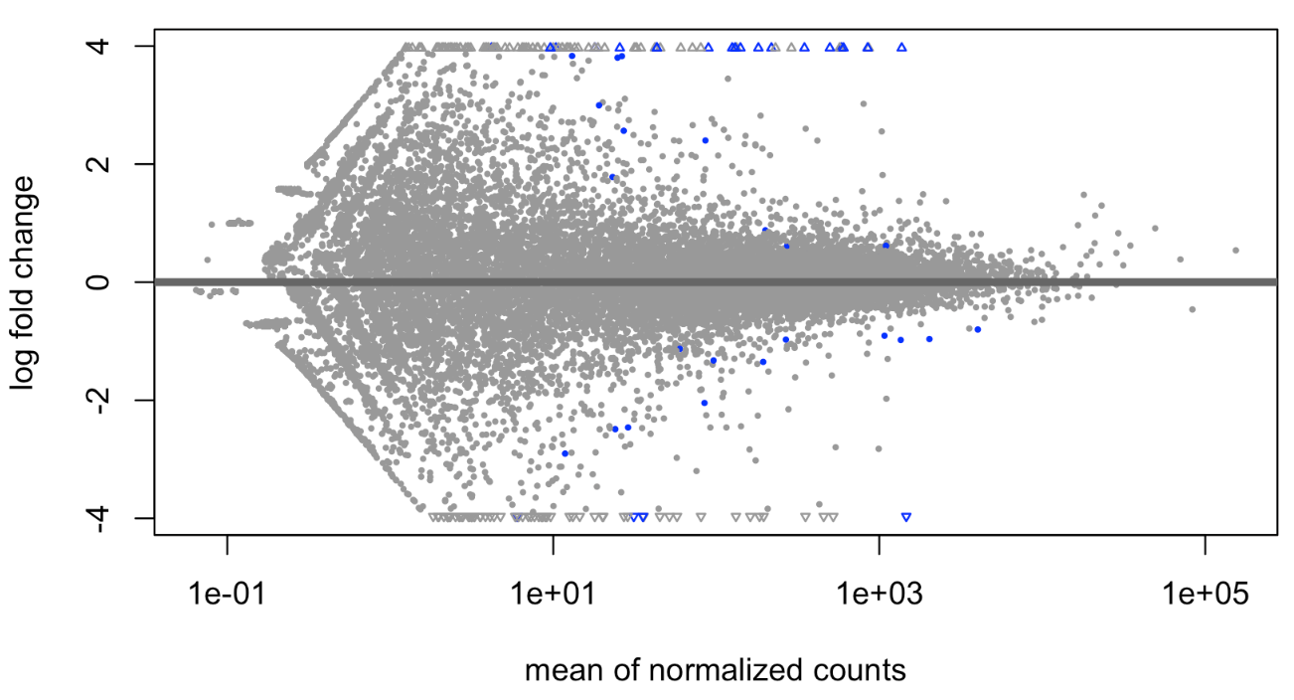
Basic plotting and visualizing of results
Notes:
basic plot shows few genes with pretty strong log fold changes are significant . BUt you can see some odd banding and stuff in the data. This is inpart becuase the genes with low counts can have very high (but pretty unreliabile ) fold changes

Slide 55
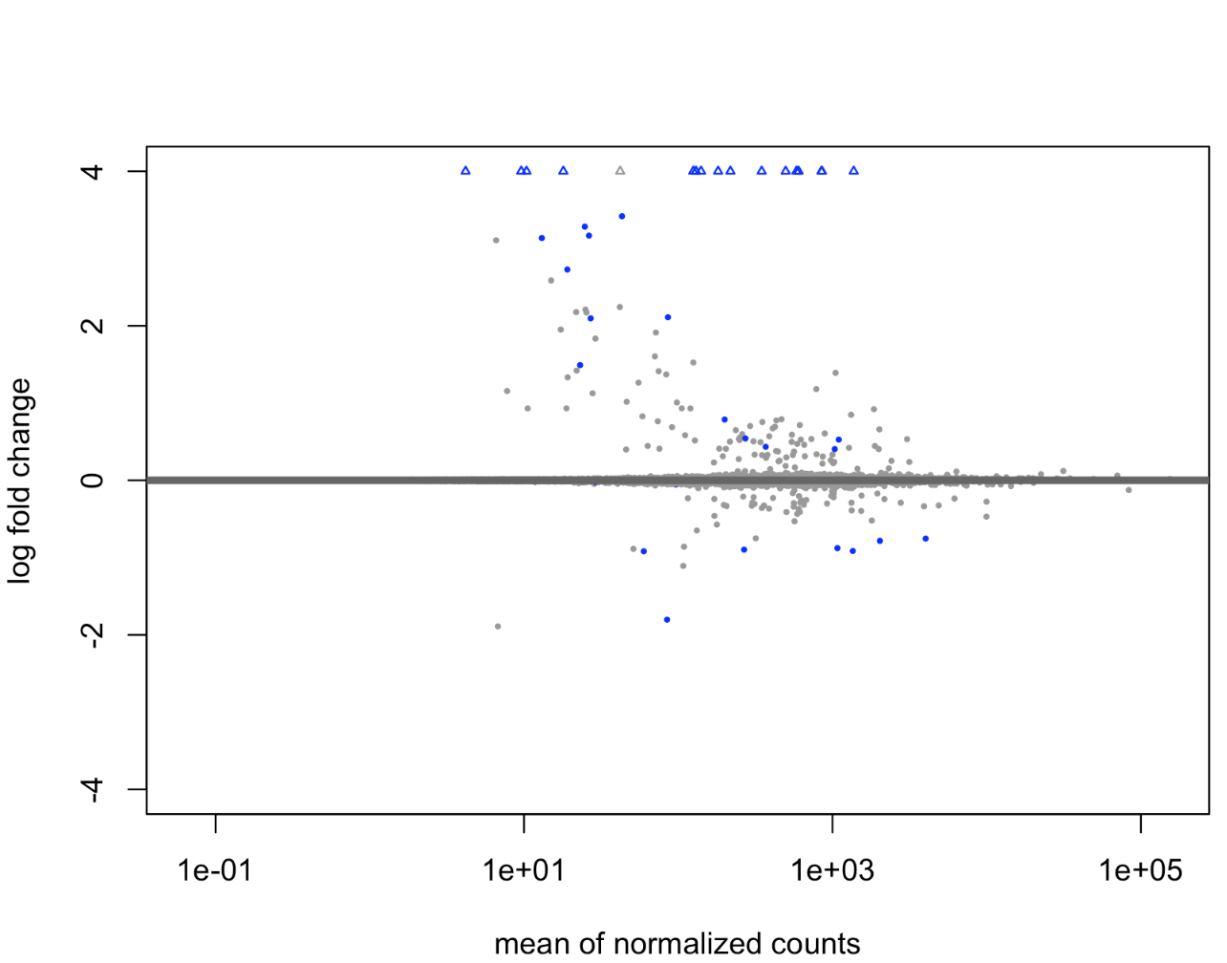
Basic plotting and visualizing of results
Initial
Shrunk

Slide 56
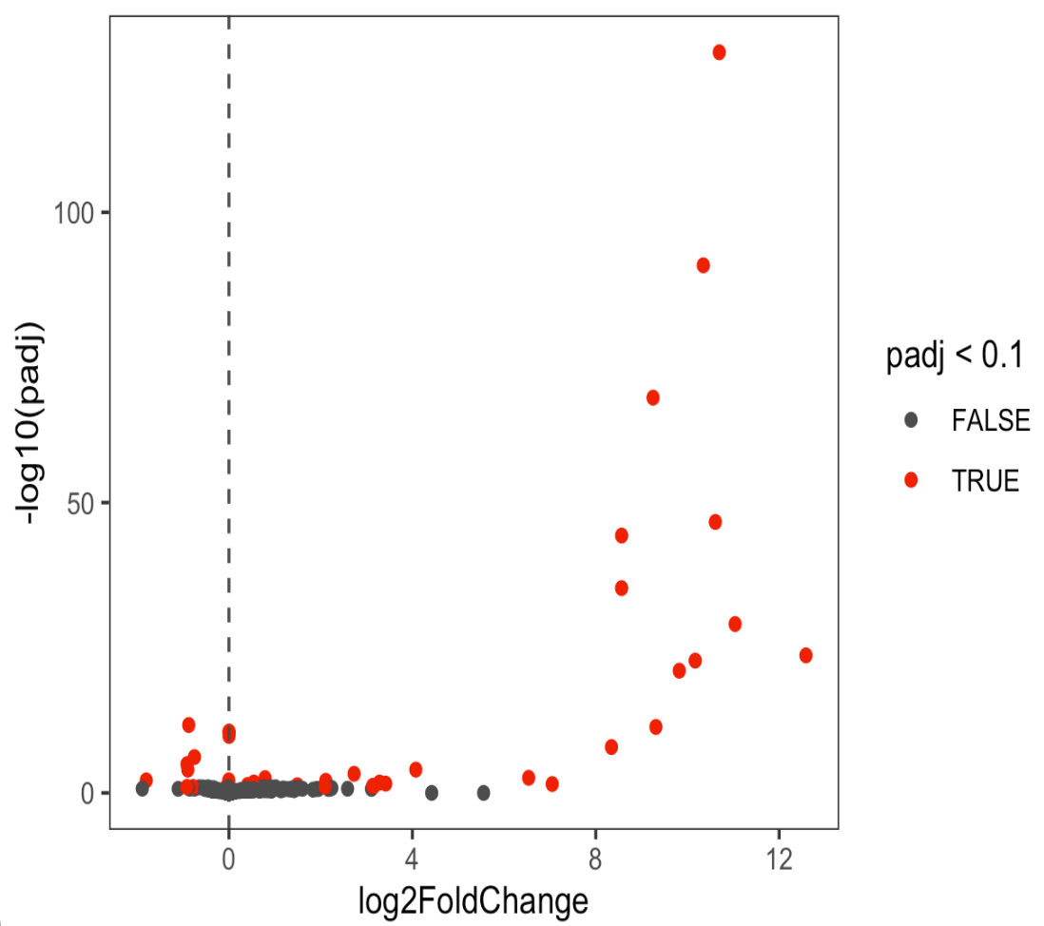
Basic plotting and visualizing of results
VolcanoPlot
Shrunk

Slide 57



Basic plotting and visualizing of results

Slide 58

Basic plotting and visualizing of results
Notes:
Important to go back to your original count data transformed somehow to do these plots
Like last time, we can see that the count data varies a lot so this is really just dominated by the total counts. Usually we want to scale this by row, so that we can see difference between groups. Also notice that one sample GM12832 is sort of off doing its own thing, which is in line with what we saw the other day.

Slide 59

Basic plotting and visualizing of results
Notes:
center = T subtracts the column mean from each value
scale = T divides these values by the standard deviation of the column
This gives you a z-score of the expression in that row.
We transpose the original matrix since scale operates on columns, then transpose again to return to the original dimensions
NOw this behaves much better and our samples cluster. Even the problem child 12832, which because we put all these values on the same scales (z-scores) a few genes with very high counts in that sample don’t drag it away.

Slide 60

Filter by Fold Change
Notes:
We tested the null hypothesis that there was not a difference in experssion between two conditions (condition A == condition B). It’s possible that we’lll have small fold changes that relate to large enough p-values to pass our threshold for significance. This coudl be becuase we have lots of replicates and very high power or because we have some very h igh expression levels that we’re pretty sure of and can mroe easily ‘see’ the difference (i.e. we’re more sure of our estimate of that genes expression in each condition).
While these might statistically be different, we might not care biologically - in practice, some will enforce a threshold of 2-fold or 1.5 fold or something like that. This experient has few genes, so I woulnd’t bother even though a couple have pretty small fold changes

Slide 61
Lecture 4 - Advanced Experimental Designs and Batch Effects

Slide 62
Data sets to illustrate
GSE102560 - shRNA KD of SWI/SNF subunits
-GSE10260_count_matrix.csv.gz
4 Groups - NS, Brg1, Brm, Double
arid2_es.Rda
mouse - ARID2 KO vs WT ES cells
4 treatment conditions (ES, EB, FGF24, FGF48)
load(arid2_es.Rda)
dds is a then a DESeqDataSet
Notes:
The count table for this will be on Sakai - which I downloaded directly from GEO

Slide 63
Batch effects
Sample | Condition | Batch
1 | A | X
2 | A | X
3 | B | Y
4 | B | Y
Notes:
These can occur when yoiu process different samples at different times. You can control for this, and remove them from the data if you carefully plan and designyour epxeriment.
This would be bad, our batches and conditions are confounded. We’ll never be able to remove the batch effect.

Slide 64
X
Batch effects
Sample | Condition | Batch
1 | A | X
2 | A | X
3 | B | Y
4 | B | Y
Sample | Condition | Batch
1 | A | X
2 | B | X
3 | A | Y
4 | B | Y
Notes:
This is much better - now each of your batches has both of your conditions. If there was an issue between batches that affected what you were measure, you likely can control for it. (Of course a real experimetn should have more than two replicatse.

Slide 65


Slide 66


PC Plot including batch and condition
Notes:
so we can see evidence of different batches here - the plus and squar (reps 3 and4 ) seem to be closer than the circle and triangle (1,2) possible we prepped those libraries in two batches of two biological replicates each.
Including batch as a covariate in the design formula lets us account for this in our differential exprsesion results.

Slide 67

Strong difference between replicates
But no difference between conditions
MT1G

Slide 68

Strong difference between replicates
But no difference between conditions
Strong difference between replicates
Still difference between groups
MT1G
CDC42EP2

Slide 69
How to handle Batch Effects
The easy way - we know which samples came from which batches
For Differential expression analysis - account for them in the DESeq design formula - Does not change underlying data
DESeqDataSet(counts, colData, design = ~ batch + condition)
For visualizing - correct the matrix to remove the effect
assay(vsd) <- limma::removeBatchEffect(assay(vsd), batch = vsd$rep)
This alters the data in the variance stabilized matrix based on the batch information in the replicate column of our design matrix
Notes:
The easy way is to model them directly into DESeq2 or however you are doing your experiment.
This essentially includes batch as a term in your design matrix. Its important to ahve batch listed first here as the last term is the effect you are interested in.
If you want to go back to count data and remove it you can use the limma package’s function removeBatchEffect

Slide 70


~ batch + condition
Notes:
you can see an incrase in power here when we account for the batch effects we observed. Since we know the replicates this is more straightforward.

Slide 71

limma::removeBatchEffect()
no correction
correction
Notes:
Lets go back and see if we can fix the pca plot by removing the batch effect - note accounting for the batch affect in DESEq does not change the underlying data at alll - here , we are actually altering our counts to remove that effect, don’t use what we do here for DE, this is just for visualizing.
After removing batch effect you can now see much better clustering of our samples - consistent with the increase in power we observed.

Slide 72

Finding Batch Effects
What if you don’t know the batches, but suspect there is a batch effect?
Notes:
lets look at our uncorrected PCA plot again - now our clusters aren’t as good and its not obvious there is a batch effect - different groups aren’t right on top of each other, but for example, these 2 NS are closer in PC2 to some none NS samples - so maybe we should look for these effects. There are (as you may have begun to see a pattern), multiple ways to do this. Two common are RUVseq and SVA for remove unwanted variation and surrogate variable analysis. RUVSeq works especially well if you have some known set of genes to use as controls, although all genes works. I’m going to demonstrate SVA - but both of these attempt to find a new variable that would explain some of the differences.

Slide 73


Finding unknown variation/batch effects
package - sva
* could also use RUVseq or comBat
Specific two models
full = ~condition {the effect(s) we care about }
reduced = ~1 { everything else , here just the intercept }
Surrogate Variables
They can be incorporated in to our design just like any other variable
Notes:
we need to have two models one that contains all our variables and one that just contains our variable of interst - so in our case we only have our condition variable (remember we’re blind about the batch variable here) - our reduce model is then just the intercept (removing that condition variable)

Slide 74



Finding unknown variation/batch effects
Notes:
Now we can use these new surrogate variables in our differnetial expresssion analysis

Slide 75
We can use the surrogate variables to correct the actual counts, just like we did with known batches before

Slide 76

uncorrected
known batches
surrogate variables

Slide 77
How do we know these methods are actually working?
Controls!

Slide 78



Permute your sample labels and test
Correct
Shuffled
redo svaseq using
the incorrect design matrix

Slide 79



Add the surrogate variables to our DESeqDataSeq
Run the DESeq analysis
Extract Results
Shuffled
Correct

Slide 80

We can use the same approach to look at PCA plots
corrected
Corrected - using permuted condition labels
Original Data

Slide 81

We can use the same approach to look at PCA plots
corrected
Permuted Data
Corrected - using permuted condition labels

Slide 82


Did our class data have a batch effect?
Original
SVA corrected

Slide 83
What if you have more than 2 groups?

Slide 84


What if you have more than 2 groups?
Use contrasts to compare them

Slide 85
What if you have more than 2 groups?
Use contrasts to compare them
Since we are using the Wald test the logfoldchanges here are interpretable as the logfoldchanges between groups.

Slide 86
Comparison of 1 condition vs a group of conditions

Slide 87
Comparison of 1 condition vs a group of conditions
This could be useful if you don’t have a true reference population
e.g. comparing a group of different cell types for example

Slide 88
Another way of comparing multiple groups: Likelihood Ratio Test (LRT)
Is there a difference between the full and reduced model
A significant p-value is telling you that the full model has more information than the reduced.
It is not telling you what that difference is
You can extract the logFoldChanges using the same approach as before for specific comparisons, but the p-values always will come from the above comparison
Full: ~ condition
Reduced: ~ 1
Notes:
This is most useful if you want to test multiple interactions or conditions at one time to see if there is any effect

Slide 89


Using the LRT to identify genes where there is a difference among your groups
The pvalues reported by LRT are for the comparison of the models (and are the same for any contrast you specify)
Fold changes will be specific to one comparison (here NS vs Brg1)

Slide 90
Multiple effects
What if you have genotype and treatment information ?
For example, you have WT and KO animals and they were treated with DrugA or Vehicle control
Depends on your questions?
What genes are affected by drug treatment
= ~ genotype + treatment
Specify which contrast you want in results (e.g. results(dds, contrast = c(‘treatment’, ‘drug’, ‘vehicle’)
What genes are affected by genotype
Specify which contrast you want in results (e.g. results(dds, contrast = c(‘genotype’, ‘KO’, ‘WT’)

Slide 91
Multiple effects
What if you have genotype and treatment information ?
For example, you have WT and KO animals and they were treated with DrugA or Vehicle control
Depends on your questions?
What genes are differentially affect by treatment in the genotypes?
~ genotype + treatment + genotype:treatment
This is where it becomes more complicated. Good specific examples in the Rnaseq workflow vignette on bioconductor
https://master.bioconductor.org/packages/release/workflows/vignettes/rnaseqGene/inst/doc/rnaseqGene.html#time-course-experiments
Often, you want to use the LRT test here, because you are interested in finding the genes with a different response to treatment by genotype
Notes:
Often better to use the LRT in this sort of design because you want to identify genes for which teh full model above, is better than one without the interaction therm

Slide 92


A concrete example
WT vs ARID2 KO
ES
EB
FGF24
FGF48
What genes does loss of ARID2 affect?
~4x increase regardless of treatment
Genotype comparison

Slide 93



A concrete example
WT vs ARID2 KO
ES
EB
FGF24
FGF48
What genes have a different outcome to treatment based on genotype?
LRT
full = ~ genotype + treatment + genotype:treatment
reduced = ~ genotype + treatment
Small p values mean that there is a genotype specific effect of one (or more) treatments
Notes:
So here you can see nothing happens in ES cells and the gene seems to be off, in the FGF treatments loss of ARID2 increase this gene, but inEB it decreases, but in EB WT cells turn this gene way up, ARID2 do not.

Slide 94
RNAseq analysis in R

Slide 95
Goals/Agenda
Why do RNA-seq
Practical advice (read depth, replicates)
Differential testing
Basic RNAseq analysis - template script using class data
QC
Normalization
Experimental design
Batch effects / complex designs
Visualizing data
Deriving biological meaning
Notes:
Here are the goals and agenda for the next couple of classes. I’m guessing this will be 3-4 lectures, we’ll see how the pace goes.
Plan is to start today with a lecture about RNA-seq techniques, approaches, and the steps involved. The overall goal is to explain and then walk through the practical steps of analyzing RNAseq data using R.
we’ll go through how to explore and QC your data. There will be some material about how to QC your data and make sure everything looks right. This is where being a biologist and computational biologist is important since you’ll understand you're samples you’ll know what to look for (sample swaps, genes that should show up in your data, etc)
The next class we’ll work through some examples for how to go from counts to differential genes.
Class 3 to talk about visualizing data and getting biological meaning from them. We’ll talk about how to make things like heatmaps and annotate functions and do enrichment profiling and stuff like that.
Class 4 will be going through the code for those methods.
We may not take the full class each time, so please interrupt and slow me down if something isn’t clear. Class 1 and 3 will be more of a lecture, with class 2 and 4 being putting some of those methods into practice. We’ll have time for a fifth class if we need to cover more hands-on computational work, or I can be available to answer questions you have about getting your code running the way you want.
I’ll make all these slide avaiable on Sakai and where I’m showing you code snippets I’ll have full Rscripts up on Sakai as well. Definitely try to go through and understand the steps on your own.

Slide 96
Why Do RNA-seq
Measure differences in gene expression between conditions
Better dynamic range and isoform/transcript information than microarrays
Detect structural variation, fusions, or single nucleotide variants
Identify new transcripts/genes
Measure ‘weird’ transcripts
Applicable to single cells
Less technical bias than microarray
Notes:
RNA-seq has largely replaced microarrays, with a few exceptions like some copy number analysis and maybe some really common gene panels or something people like. But I’ve only ever run like 1 or 2 microarrays (as a rotation student) . It can still be useful to learn how to analyze that data since so much is in GEO (gene expression omnibus). Analyzing other peoples data, a so-called data parasite, is one of my favorite things to do since at least reagent-wise its free
The big thing you want to do is “Measure differences in gene expression” and this can be expanded to look not just at a a gene as one thing, but isoforms or alternative starts or polyA sites
A lot of folks, especially in cancer are looking for “fusions, structural variants, or single nucleotide variation” that might indicate a mutation of some sort.
Possible to identify new genes - with RNA-seq you don’t necessarily need a transcriptome before you start, so this can work on non-model organisms or poorly annotated genomes. This will require more reads and thought in how you analyze the data.
You “can analyze weird transcripts” - some transcripts are poorly represented on commercial microarrays like lncRNAs or various small RNAs or transposable elements. You can map really any transcribed region of the genome. You can also assay RNAs associated with the ribosome or different subcellular locations (cytoplasmic vs nuclear RNA) or enhancers. This may all reveal important biology
More recently, single cell RNAseq, has started to become really common. My personal view is analysis has a long way to go here. I read there are more papers with new analysis methods than there are RNAseq data sets and people handle variation/replicates poorly right now. BUt its pretty clear more and more single cell data are going to be coming during the time you’re all here (at least in UNC, but maybe in this module)
There are fewer technical artifacts in RNA-seq

Slide 97
Technical Bias in expression analysis
Microarray
Luo et al., MAQC-II 2010
Notes:
One major advantage vs arrays is lower technical variance . This is array data processed on 3 different versions of the array chips on the let or two different manufactureres and you can see by principle components huge differences driven just by the array itself.

Slide 98
Technical Bias in expression analysis
Microarray
RNA-seq
Luo et al., MAQC-II 2010
Joel Parker
Notes:
On the right are some data I borrowed from Joel Parker’s slide on technical variation where they did RNA-seq using several different sequencing sites and this scatter plot of the principle componenets shows neraly complete overlap of the clusters - so the technical effects due to the actual machines used is pretty low.
There are still pretty serious technical or batch effects that can cause challenges, but for RNA-seq this seems to be more driven by the library prep steps rather than the sequencing step.s

Slide 99
RNA-seq biases
Joel Parker

Slide 100
Practical considerations in RNA-seq processing and experimental design

Slide 101
Sequencing Parameters
Key Points
> 25bp
Single end fine for DE - paired end might help mapping/splicing
Joel Parker

Slide 102
Read Depth / Sensitivity
For DE of mRNA 20-30 million, deeper if you are looking for rare transcripts/events
Library type affects needed depth
Joel Parker

Slide 103
More Depth or More Replicates
Replicates >>>>> Depth
More replicates
Liu et. al. (2014) Bioinformatics

Slide 104
How to handle multimapping
Joel Parker

Slide 105
Approach 1: Ignore them
Joel Parker
Notes:
Ignoring them was the first approach but leads to a potentially seroius error (
This over-estimates the abundance of reads that are from highly unique genes - so transcript 3 here w
It understimates genes with some amount of repetitiveness.

Slide 106
Approach 2: Fractional Allocation
Assign based on previous abundances
Joel Parker
Notes:
This is the approach that more or less has stuck and people have iterated on.
Cufflinks started by trying to figure out which transcript a multimapped read was more likely to come from by first alining unique reads and then doing a single pass step where reads were assigned based on a these prior abundancces
RSEM took this idea further by using expectation maximization steps where multiple rounds of fractional assignment were used to update the abundance estimates until you reached a convergence point. This can be pretty computationally intensive (slow and high memory usage)
Salmon/Kallisto use a streaming approach where they look at each read one at a time and assign it based no the reads already counted. THis requires that reads be randomly streamed in and not sorted somehow before. Both methods can also work without ever doing the alignment step where reads are shredded into kmers and the smaller kmers are used to exactly match transcripts which can be very fast

Slide 107
Memory Usage
Kallisto: 282 +/- 22.5, 399M
Salmon: 287.6 +/- 27.4, 339M
RSEM: 8.7, 16GB
Runtime
Kallisto: 11 + /- 3.5, 23 minutes
Salmon: 9.55 +/- 2.2, 15 minutes
RSEM: 9.1 +/- 3.5 15 hours
Joel Parker

Slide 108
Computational Processing Overview
Technical variation from sequencing is pretty small - but can be present based on library preparation strategies and batches
Raw results require significant computation processing - many approaches
Alignment : How to deal with ambiguous alignments, mapping across splice junctions, identifying new transcripts: Bowtie, Tophat, STAR, HiSat
Abundance Estimation: Gene or transcript; alignment based or alignment free, what to do with multimapping. RSEM, Cufflinks, Salmon, Kallisto, featureCounts
Normalization strategies: Total reads, upper quartile, effects of length, median ratios

Slide 109
RNA-seq Workflow
Samples
Genes
Raw Counts
Visualization/Quality Control
Differential Expression
DESeq2::vst()
DESeq2::rlog()
DESeq2::plotPCA()
DESeq2::plotCounts()
ComplexHeatmap::Heatmap()
DESeq2::DESeq()
DESeq2::results()
Package::function()
https://bioconductor.org/packages/devel/bioc/vignettes/DESeq2/inst/doc/DESeq2.html

Slide 110
RNA-seq Workflow
Samples
Genes
Raw Counts
Visualization/Quality Control
Differential Expression
DESeq2::vst()
DESeq2::rlog()
DESeq2::plotPCA()
DESeq2::plotCounts()
ComplexHeatmap::Heatmap()
DESeq2::DESeq()
DESeq2::results()
edgeR::glmFit()
edgeR::glmLRT()
edgeR::topTags()
Biological Inference
Gene set enrichment
ComplexHeatmap::Heatmap
DESeq2::plotMA

Slide 111

Getting your quantification data into R
Notes:
We use biomart to look up the annotatin mappings between ensembl’s transcript IDS and gene names (here external_gene_name) to give something I recognize when I look at the DE table.
Then we do the improt using tximport. It reads from the path we specificed, we tell it salmon did the quantification, and use tx2gene to map transcripts to genes. IgnoreTx version drops the little suffix number in the ensembl transcript id.
This gives us a list that contains a table of counts. One very important parameter is countsFromAbundance, which I Have as false. This allows scaling the counts by the transcript lengths which may change betwen conditions. If you make this True you can use the count table in txi directly - either way is fine, but I’d encourage you to be explicit in how you’ve coded this
Finally, We feed that whole thing into DESeq2 using the datasetfrommatrix call and specificy our groups using the designn = ~ Group) this is how you specificy the formula. We’ll come to more advanced formula designs in a bit, or maybe nexttime).

Slide 112


Slide 113

Getting your quantification data into R
Notes:
Now we need to read those files in. I’m using a few packages from R for this, DEseq2 for its ability to make a nice summarizedExperiment object (I’ll come back to this in a few slides) , tximport is handy for reading in data from salmon and other quantification strategies. It can summarize to genes from transcripts (recall you may have more than one transcript fromt he same gene in your data set) I usually want to work at gene level and it is the simplest to do, but let your biological question the analyssi you want to do. You may care about transcript or isoform differences. Maybe you are interested in specific exon usage or that sort =of things.
We use biomart to look up the annotatin mappings between ensembl’s transcript IDS and gene names (here external_gene_name) to give something I recognize when I look at the DE table.
Then we do the improt using tximport. It reads from the path we specificed, we tell it salmon did the quantification, and use tx2gene to map transcripts to genes. IgnoreTx version drops the little suffix number in the ensembl transcript id.
This gives us a list that contains a table of counts. One very important parameter is countsFromAbundance, which I Have as false. This allows scaling the counts by the transcript lengths which may change betwen conditions. If you make this True you can use the count table in txi directly - either way is fine, but I’d encourage you to be explicit in how you’ve coded this
Finally, We feed that whole thing into DESeq2 using the datasetfrommatrix call and specificy our groups using the designn = ~ Group) this is how you specificy the formula. We’ll come to more advanced formula designs in a bit, or maybe nexttime).

Slide 114

Getting your quantification data into R
Notes:
\

Slide 115


Slide 116

Notes:
A useful function in R is str() which tells you the structure of some data you ahve. Here I ran it on txi and it tells me this is a list of 4 elements - those elements have names= abundance, counts, length, countsfFromabundance. which gives us information about the genes, counts, expression, etc.

Slide 117

Getting your quantification data into R
D
DESeqDataSet is a special kind of variable called a SummarizedExperiment
Notes:
dds now contains our DESeq summarizedExperiment object - which contains our information about counts, samples AND our design information.
At this point you can go on to do DE, or you can explore the data. bit. TOday we’re going to do some qc to see how our data look. I think this is generally a good approach because I like understanding what my data look like, but its also fine to run the DE and come back and look at your samples a little more closely later. You should look at these sorts of plots, and therea re a couple of pitfalls I’ll show that you may want to know about before doing the DESeq analysis.

Slide 118
Getting Started
Alliteratively - if you use a tool like featureCounts or already have a count matrix
Samples
Count Matrix
Notes:
You could do similarly iwth any matrix of count data you have. This is an example of how I’d do it for quantitation data from featureCounts. You can read that table in directly, but the first 6 columns describe some information about the annotations we used to quantify. I really only want the geneid here, so I keep that as an additional variable, and make the rest a matrix. I do a little bit int he middle to clean up the column names so that my column names and the Sample names in my design table match (AND ARE IN THE SAME ORDER)

Slide 119
What is a summarized experiment object
RangedSummarizedExperiment - these represent genomic ranges
DESeqDataSet
Non-negative integer counts
Must have a formula describing experiment design
SummarizedExperiment -
https://bioconductor.org/packages/release/bioc/vignettes/SummarizedExperiment/inst/doc/SummarizedExperiment.html
Notes:
I have mentioned that dds is a ‘SummarizedExperiment’ object , what is this. DDS is actually a DEseqDataset - which itself is an extension of RangedSummarizedExperiments which is an extension of SummarizedExperiment.
These are something a little more fancy than a list or a dataframe or a string. These are called objects and the bioconductor project has tried to formalize the usage of a specific style of these objects for genomics data.

Slide 120
Goals in RNA-seq Analysis
Samples
Genes
Raw Counts
Visualization/Quality Control
Differential Expression
DESeq2::vst()
DESeq2::rlog()
DESeq2::plotPCA()
DESeq2::plotCounts()
ComplexHeatmap::Heatmap()
DESeq2::DESeq()
DESeq2::results()
R code for Differential Expression
Full annotated methods in salmon_DE.R
Notes:
So now that we have our data into a DESeq object we can do either of these two paths, and we need to do both. I’m going use the time we have left to show some visualization/quality control things about our data.
Next time we’ll do the differenetial expression side, work through that code and talk about what DESeq is actually doing

Slide 121
Lecture 2
Recap
More replicates more important than more reads/sample
20-30 million/sample
How to import Salmon data in R (tximport)
Make a DESeqDataset (DESeqDataSetFromTximport)
Calculate differentially expressed genes (DESeq)
Full annotated methods in salmon_DE.R

Slide 122


R practice - see intro_R_notes_4.R
pivot_longer(cols = c(Sample1, Sample2, Sample3), names_to = ‘Sample’, values_to = ‘value’)
pivot_longer(cols = -Gene, names_to = ‘Sample’, values_to = ‘value’)
pivot_wider(names_from = ‘Sample’, values_from = ‘value’)

Slide 123
Goals in RNA-seq Analysis
Samples
Genes
Raw Counts
Visualization/Quality Control
Differential Expression
DESeq2::vst()
DESeq2::rlog()
DESeq2::plotPCA()
DESeq2::plotCounts()
ComplexHeatmap::Heatmap()
DESeq2::DESeq()
DESeq2::results()
edgeR::glmFit()
edgeR::glmLRT()
edgeR::topTags()
Biological Inference
Gene set enrichment
ComplexHeatmap::Heatmap
DESeq2::plotMA

Slide 124
Goals in RNA-seq Analysis
Samples
Genes
Raw Counts
Differential Expression
estimateSizeFactors
estimateDispersions
DESeq2::DESeq()
DESeq2::results()
GLM fit for each gene
edgeR::glmFit()
edgeR::glmLRT()
edgeR::topTags()

Slide 125
Goals in RNA-seq Analysis
Samples
Genes
Raw Counts
Differential Expression
DESeq2::DESeq()
DESeq2::results()
edgeR::glmFit()
edgeR::glmLRT()
edgeR::topTags()
Wald Test (Default)
Likelihood Ratio Test
Notes:
Choosing between these tests is a little confusing ( I generally have to look this up when I’m doing something more complicated thanusual).
Wald test works well when you are doing pairwise comparisons - so what chagnes change between drug and vehicle treatmentes. pvalues here are telling you whch fold changes are significantly different.
LRT tests are appropriate for timecourse of if you want to analyze all levels of a factor at once. Say for example you have drug a drug b drug c and vehicle and you want to see which genes change - here the pvalue tells you that including your treatment condition in the model provides value to the model, it doesn’t relate to a specific lfc comparison.

Slide 126
You could run these steps independently
DESeq
Estimate size factors
estimateSizeFactors()
Estimate dispersion
estimateDispersion()
Fit negative binomial GLM
nbinomWaldTest()
nbinomLRT()

Slide 127
DESeq Results
des <- DESeq(dds)
Estimate Size Factors
What are size factors?
Generate a reference sample from the geometric mean of all samples
Estimate gene-wise dispersions
Get ratio of each sample to that ‘reference’
Fit curve to dispersion estimates
Shrink gene-wise dispersion estimates
GLM for each gene

Slide 128
DESeq Results
des <- DESeq(dds)
Estimate Size Factors
Estimate gene-wise dispersions
Fit curve to dispersion estimates
Shrink gene-wise dispersion estimates
GLM for each gene

Slide 129
DESeq Results
des <- DESeq(dds)
Estimate Size Factors
Estimate gene-wise dispersions
Fit curve to dispersion estimates
Shrink gene-wise dispersion estimates
GLM for each gene
What is this fit doing?

Slide 130
DESEq Theory
$$K_{ij}∼\text{NB}(μ_{ij},α_{i})$$
Observed Counts
Mean
Dispersion
Notes:
A really deep understanding of the model here I don’t think is necessary, but its good to have a little understanding of why we use this model and approach for RNA seq. This formula essentially is saying we are modeling the count data (K) for the ith gene in the jth sample from a binomial distribution. This binomial distribution has two parameters, the mean and the dispersion. We use negative binomal instead of say, the normal distribution becaues as what we are measuring is count data, it can’t be normally distributed,we cant have -3 reads for example. Count data can be measured with a Poisson distributiojn,b ut this assumes that variance does not change with the mean. As we talkea bout last time, genes with low counts have high dispersion so we see dependece on expression level.

Slide 131
DESEq Theory
$$K_{ij}∼\text{NB}(μ_{ij},α_{i})$$
Observed Counts
Mean
gene-specific dispersion
$$μ_{ij}=s_{j}q_{ij}$$
Size Factor
Concentration of fragments
in sample
Notes:
A really deep understanding of the model here I don’t think is necessary, but its good to have a little understanding of why we use this model and approach for RNA seq. This formula essentially is saying we are modeling the count data (K) for the ith gene in the jth sample from a binomial distribution. This binomial distribution has two parameters, the mean and the dispersion. We use negative binomal instead of say, the normal distribution becaues as what we are measuring is count data, it can’t be normally distributed,we cant have -3 reads for example. Count data can be measured with a Poisson distributiojn,b ut this assumes that variance does not change with the mean. As we talkea bout last time, genes with low counts have high dispersion so we see dependece on expression level.

Slide 132
Hypothesis Testing
Wald: (default) - Is the LFC == 0 (null)
LRT (two or more classes) : Does the full model add anything to the fit
e.g full model ~ Group
reduced model ~ 1 (intercept)
LRT (two or more classes) : Does the full model add anything to the fit
e.g full model ~ Genotype+ Treatment
reduced model ~ Genotype
Notes:
Wald does this by taking LFC and dividing by SE to get a z-statistic which is compared to the normal distribution to get a p-value ( the liklihood of observing this or a more extreme statistic if the null were tru)
LRT tells you if there is any difference between the condition of interst, the LFC values are not informative though. You can extract individual comparisons using Wald tests -we will go into more depth about different formula and extracting meaning from these tests next time.

Slide 133
DESeq Code

Slide 134
Quality Control and Data Visualization
Do experimental groups look right
Does number of reads makes sense
Do replicates cluster together
Are there potential batch effects/biases

Slide 135
Total counts per sample

Slide 136
Normalized using DESeq
Notes:
Trrying to evaluate if there are any imbalances in the data or groups we should take note of.
On the right side is the non-normalized raw count data (this will be the input do DESEq analysis next time). The left side is normalized data where we’ve taking the count matrix back out of the DESeq object and normalized it using the sizefactors DESeq estmiates.
This is probably not the best way to do this, and DESeq includes two better approaches rlog and vst which are useful when you want to do clustering or anything related to distances between samples.

Slide 137
Data transformations
Log2(n+1)
vst
rlog
https://bioconductor.org/packages/release/bioc/vignettes/DESeq2/inst/doc/DESeq2.html#data-transformations-and-visualization
Notes:
One problem we are trying to solve with normalization approaches is correting for library size - the other major problem is that the variance of a gene depends on its mean. I took these plots from the DESEq2 manual at the bottom.
bThis means that low expressed genes have high standard deviations of expresion. Ideally you’d want to have constant variation across expression range. The first plot is just the log2 value of the counts. You can see low expressed genes have higher standard deviations.
VST fixes this and you get relatively constant sd across the expression range
Rlog also flattens this in the low end, but possibly a bit too much. I think both vst and rlog are likely appropriate for most analyes, but vst is a little faster.

Slide 138
vst and rlog transformations
Notes:
These functions are described well int he DESeq documentation, both do roughly equivalent things, vst is faster and is the one I usually use.
Walk through code -
SO you can see for both vst and rlog the normalzied data look relatively simialr and there are not obvious gorup differences remaining after this transformation. That doesn’t mean there are no biases or batch effects, but nothing very obvious jumps out to me here.

Slide 139
A better way - rlog and VST
Sample2
Sample1
Sample1
At low expression
Noise is dominating
Better,
shifts expression of lower expressed genes
Shrinks low counts
Notes:
We can compare two samples using these plots as well. This also comes form the DESEq2 manual. Here we are comparing two samples that we’ve transformed using one of the three prevouis methods
I think you can really appreciate how noisy the shifted log version is - the low values are just all over the place due to noise of counting those weakly expressed genes.
vst is faster and maybe is then better for bigger data sets,but might be a bit more sensitive to outliers. - while rlog might work a bit better on small datasets, but isn’t as good if you have a huge range of sequencing depth (like more than an order of magnitude)
You can try both but they should give relatively similar results
These are important as the variance of your data will increase as the mean does. These variances will dominate princple components and other visualization methods.

Slide 140
blind = T

Slide 141
blind = T
blind = F

Slide 142
Sample Clustering
Notes:
What you’re looking for hear is that samples cluster based on replciates. Pretty clearly we aren’t getting very good cluster separeation. Next time we’ll look for hidden batch effects to see if that can improve clustering - and then move on to DE analysis.

Slide 143
R code for QC

Slide 144
Lecture 3

Slide 145
P-values
Notes:
some of these are just by chance - you can sort of look at th edistrubtion and assume at least ~800 of them are, but there could be a few hundred p-values that really are - we use an correction for multiple testing to find these.
Default here is false discovery rate (benjami hochberg) -or the proportion of false discoveries - so with an FDR of 0.1, we expect ~10% of the rejected null hypothesis to be an error, and to actually be just due to chance.

Slide 146
Basic plotting and visualizing of results
Notes:
basic plot shows few genes with pretty strong log fold changes are significant . BUt you can see some odd banding and stuff in the data. This is inpart becuase the genes with low counts can have very high (but pretty unreliabile ) fold changes

Slide 147
Basic plotting and visualizing of results
Initial
Shrunk

Slide 148
Basic plotting and visualizing of results
VolcanoPlot
Shrunk

Slide 149
Basic plotting and visualizing of results

Slide 150
Basic plotting and visualizing of results
Notes:
Important to go back to your original count data transformed somehow to do these plots
Like last time, we can see that the count data varies a lot so this is really just dominated by the total counts. Usually we want to scale this by row, so that we can see difference between groups. Also notice that one sample GM12832 is sort of off doing its own thing, which is in line with what we saw the other day.

Slide 151
Basic plotting and visualizing of results
Notes:
center = T subtracts the column mean from each value
scale = T divides these values by the standard deviation of the column
This gives you a z-score of the expression in that row.
We transpose the original matrix since scale operates on columns, then transpose again to return to the original dimensions
NOw this behaves much better and our samples cluster. Even the problem child 12832, which because we put all these values on the same scales (z-scores) a few genes with very high counts in that sample don’t drag it away.

Slide 152
Filter by Fold Change
Notes:
We tested the null hypothesis that there was not a difference in experssion between two conditions (condition A == condition B). It’s possible that we’lll have small fold changes that relate to large enough p-values to pass our threshold for significance. This coudl be becuase we have lots of replicates and very high power or because we have some very h igh expression levels that we’re pretty sure of and can mroe easily ‘see’ the difference (i.e. we’re more sure of our estimate of that genes expression in each condition).
While these might statistically be different, we might not care biologically - in practice, some will enforce a threshold of 2-fold or 1.5 fold or something like that. This experient has few genes, so I woulnd’t bother even though a couple have pretty small fold changes

Slide 153
Lecture 4 - Advanced Experimental Designs and Batch Effects

Slide 154
Data sets to illustrate
GSE102560 - shRNA KD of SWI/SNF subunits
-GSE10260_count_matrix.csv.gz
4 Groups - NS, Brg1, Brm, Double
arid2_es.Rda
mouse - ARID2 KO vs WT ES cells
4 treatment conditions (ES, EB, FGF24, FGF48)
load(arid2_es.Rda)
dds is a then a DESeqDataSet
Notes:
The count table for this will be on Sakai - which I downloaded directly from GEO

Slide 155
Batch effects
Sample | Condition | Batch
1 | A | X
2 | A | X
3 | B | Y
4 | B | Y
Notes:
These can occur when yoiu process different samples at different times. You can control for this, and remove them from the data if you carefully plan and designyour epxeriment.
This would be bad, our batches and conditions are confounded. We’ll never be able to remove the batch effect.

Slide 156
X
Batch effects
Sample | Condition | Batch
1 | A | X
2 | A | X
3 | B | Y
4 | B | Y
Sample | Condition | Batch
1 | A | X
2 | B | X
3 | A | Y
4 | B | Y
Notes:
This is much better - now each of your batches has both of your conditions. If there was an issue between batches that affected what you were measure, you likely can control for it. (Of course a real experimetn should have more than two replicatse.

Slide 158
PC Plot including batch and condition
Notes:
so we can see evidence of different batches here - the plus and squar (reps 3 and4 ) seem to be closer than the circle and triangle (1,2) possible we prepped those libraries in two batches of two biological replicates each.
Including batch as a covariate in the design formula lets us account for this in our differential exprsesion results.

Slide 159
Strong difference between replicates
But no difference between conditions
MT1G

Slide 160
Strong difference between replicates
But no difference between conditions
Strong difference between replicates
Still difference between groups
MT1G
CDC42EP2

Slide 161
How to handle Batch Effects
The easy way - we know which samples came from which batches
For Differential expression analysis - account for them in the DESeq design formula - Does not change underlying data
DESeqDataSet(counts, colData, design = ~ batch + condition)
For visualizing - correct the matrix to remove the effect
assay(vsd) <- limma::removeBatchEffect(assay(vsd), batch = vsd$rep)
This alters the data in the variance stabilized matrix based on the batch information in the replicate column of our design matrix
Notes:
The easy way is to model them directly into DESeq2 or however you are doing your experiment.
This essentially includes batch as a term in your design matrix. Its important to ahve batch listed first here as the last term is the effect you are interested in.
If you want to go back to count data and remove it you can use the limma package’s function removeBatchEffect

Slide 162
~ batch + condition
Notes:
you can see an incrase in power here when we account for the batch effects we observed. Since we know the replicates this is more straightforward.

Slide 163
limma::removeBatchEffect()
no correction
correction
Notes:
Lets go back and see if we can fix the pca plot by removing the batch effect - note accounting for the batch affect in DESEq does not change the underlying data at alll - here , we are actually altering our counts to remove that effect, don’t use what we do here for DE, this is just for visualizing.
After removing batch effect you can now see much better clustering of our samples - consistent with the increase in power we observed.

Slide 164
Finding Batch Effects
What if you don’t know the batches, but suspect there is a batch effect?
Notes:
lets look at our uncorrected PCA plot again - now our clusters aren’t as good and its not obvious there is a batch effect - different groups aren’t right on top of each other, but for example, these 2 NS are closer in PC2 to some none NS samples - so maybe we should look for these effects. There are (as you may have begun to see a pattern), multiple ways to do this. Two common are RUVseq and SVA for remove unwanted variation and surrogate variable analysis. RUVSeq works especially well if you have some known set of genes to use as controls, although all genes works. I’m going to demonstrate SVA - but both of these attempt to find a new variable that would explain some of the differences.

Slide 165
Finding unknown variation/batch effects
package - sva
* could also use RUVseq or comBat
Specific two models
full = ~condition {the effect(s) we care about }
reduced = ~1 { everything else , here just the intercept }
Surrogate Variables
They can be incorporated in to our design just like any other variable
Notes:
we need to have two models one that contains all our variables and one that just contains our variable of interst - so in our case we only have our condition variable (remember we’re blind about the batch variable here) - our reduce model is then just the intercept (removing that condition variable)

Slide 166
Finding unknown variation/batch effects
Notes:
Now we can use these new surrogate variables in our differnetial expresssion analysis

Slide 167
We can use the surrogate variables to correct the actual counts, just like we did with known batches before

Slide 168
uncorrected
known batches
surrogate variables

Slide 169
How do we know these methods are actually working?
Controls!

Slide 170
Permute your sample labels and test
Correct
Shuffled
redo svaseq using
the incorrect design matrix

Slide 171
Add the surrogate variables to our DESeqDataSeq
Run the DESeq analysis
Extract Results
Shuffled
Correct

Slide 172
We can use the same approach to look at PCA plots
corrected
Corrected - using permuted condition labels
Original Data

Slide 173
We can use the same approach to look at PCA plots
corrected
Permuted Data
Corrected - using permuted condition labels

Slide 174
Did our class data have a batch effect?
Original
SVA corrected

Slide 175
What if you have more than 2 groups?

Slide 176
What if you have more than 2 groups?
Use contrasts to compare them

Slide 177
What if you have more than 2 groups?
Use contrasts to compare them
Since we are using the Wald test the logfoldchanges here are interpretable as the logfoldchanges between groups.

Slide 178
Comparison of 1 condition vs a group of conditions

Slide 179
Comparison of 1 condition vs a group of conditions
This could be useful if you don’t have a true reference population
e.g. comparing a group of different cell types for example

Slide 180
Another way of comparing multiple groups: Likelihood Ratio Test (LRT)
Is there a difference between the full and reduced model
A significant p-value is telling you that the full model has more information than the reduced.
It is not telling you what that difference is
You can extract the logFoldChanges using the same approach as before for specific comparisons, but the p-values always will come from the above comparison
Full: ~ condition
Reduced: ~ 1
Notes:
This is most useful if you want to test multiple interactions or conditions at one time to see if there is any effect

Slide 181
Using the LRT to identify genes where there is a difference among your groups
The pvalues reported by LRT are for the comparison of the models (and are the same for any contrast you specify)
Fold changes will be specific to one comparison (here NS vs Brg1)

Slide 182
Multiple effects
What if you have genotype and treatment information ?
For example, you have WT and KO animals and they were treated with DrugA or Vehicle control
Depends on your questions?
What genes are affected by drug treatment
= ~ genotype + treatment
Specify which contrast you want in results (e.g. results(dds, contrast = c(‘treatment’, ‘drug’, ‘vehicle’)
What genes are affected by genotype
Specify which contrast you want in results (e.g. results(dds, contrast = c(‘genotype’, ‘KO’, ‘WT’)

Slide 183
Multiple effects
What if you have genotype and treatment information ?
For example, you have WT and KO animals and they were treated with DrugA or Vehicle control
Depends on your questions?
What genes are differentially affect by treatment in the genotypes?
~ genotype + treatment + genotype:treatment
This is where it becomes more complicated. Good specific examples in the Rnaseq workflow vignette on bioconductor
https://master.bioconductor.org/packages/release/workflows/vignettes/rnaseqGene/inst/doc/rnaseqGene.html#time-course-experiments
Often, you want to use the LRT test here, because you are interested in finding the genes with a different response to treatment by genotype
Notes:
Often better to use the LRT in this sort of design because you want to identify genes for which teh full model above, is better than one without the interaction therm

Slide 184
A concrete example
WT vs ARID2 KO
ES
EB
FGF24
FGF48
What genes does loss of ARID2 affect?
~4x increase regardless of treatment
Genotype comparison

Slide 185
A concrete example
WT vs ARID2 KO
ES
EB
FGF24
FGF48
What genes have a different outcome to treatment based on genotype?
LRT
full = ~ genotype + treatment + genotype:treatment
reduced = ~ genotype + treatment
Small p values mean that there is a genotype specific effect of one (or more) treatments
Notes:
So here you can see nothing happens in ES cells and the gene seems to be off, in the FGF treatments loss of ARID2 increase this gene, but inEB it decreases, but in EB WT cells turn this gene way up, ARID2 do not.

